Slide 1
Chapter 14 Strings, Characters and Regular Expressions
Java How to Program, 11/e

Slide 2
Course Objectives
Understand an use the concept of structured problem solving.
Understand the use of abstraction in problem solving.
Understand and use the basics of software development principles.

Slide 3
Chapter Objectives
Construct and manipulate immutable character-strings objects of the class String.
Construct and manipulate mutable character-string objects fo the class StringBuilder.
Construct and manipulate objects of class Character.
Describe breaking a string object into tokens using the String method split.

Slide 4
14.1 Introduction
This chapter discusses class String, class StringBuilder and class Character from the java.lang package.
These classes provide the foundation for string and character manipulation in Java.

Slide 5
14.2 Fundamentals of Characters and Strings
A program may contain character literals.
An integer value represented as a character in single quotes.
The value of a character literal is the integer value of the character in the Unicode character set.
String literals (stored in memory as String objects) are written as a sequence of characters in double quotation marks.

Slide 6
14.3 Class String
Class String is used to represent strings in Java.
The next several subsections cover many of class String’s capabilities.

Slide 7
14.3.1 String Constructors
No-argument constructor creates a String that contains no characters (i.e., the empty string, which can also be represented as "") and has a length of 0.
Constructor that takes a String object copies the argument into the new String.
Constructor that takes a char array creates a String containing a copy of the characters in the array.
Constructor that takes a char array and two integers creates a String containing the specified portion of the array.

Slide 8
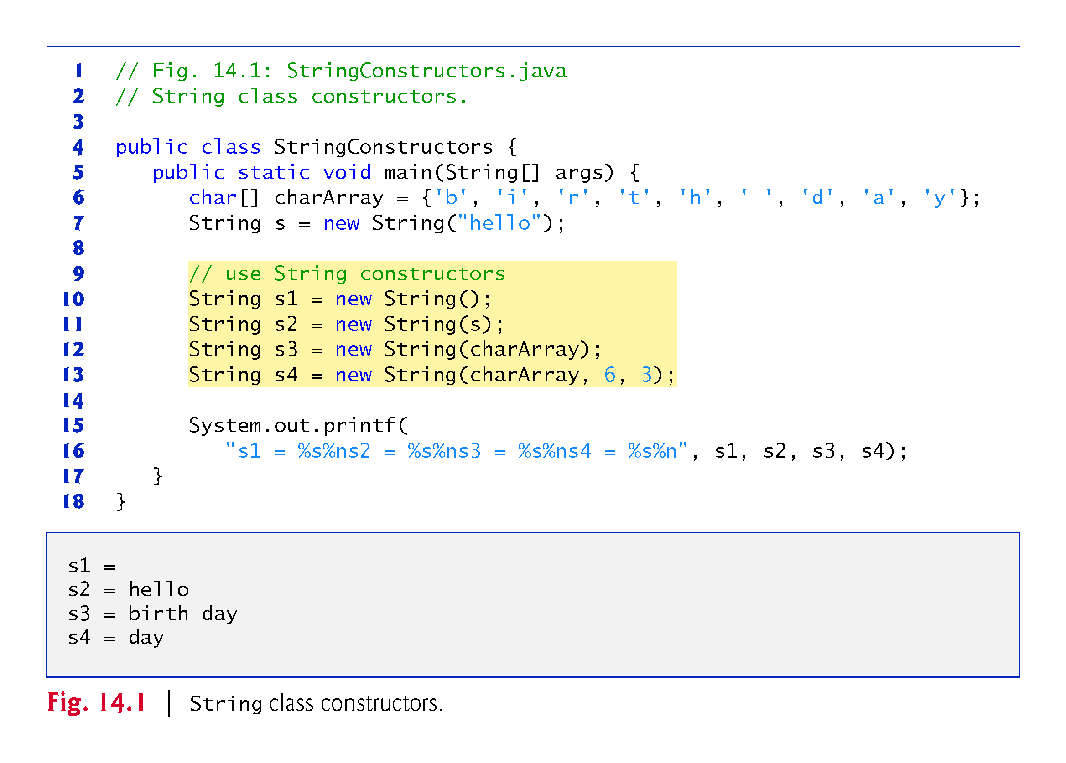

Slide 9
14.3.2 String Methods length, charAt and getChars
String method length determines the number of characters in a string.
String method charAt returns the character at a specific position in the String.
String method getChars copies the characters of a String into a character array.
The first argument is the starting index in the String from which characters are to be copied.
The second argument is the index that is one past the last character to be copied from the String.
The third argument is the character array into which the characters are to be copied.
The last argument is the starting index where the copied characters are placed in the target character array.

Slide 10
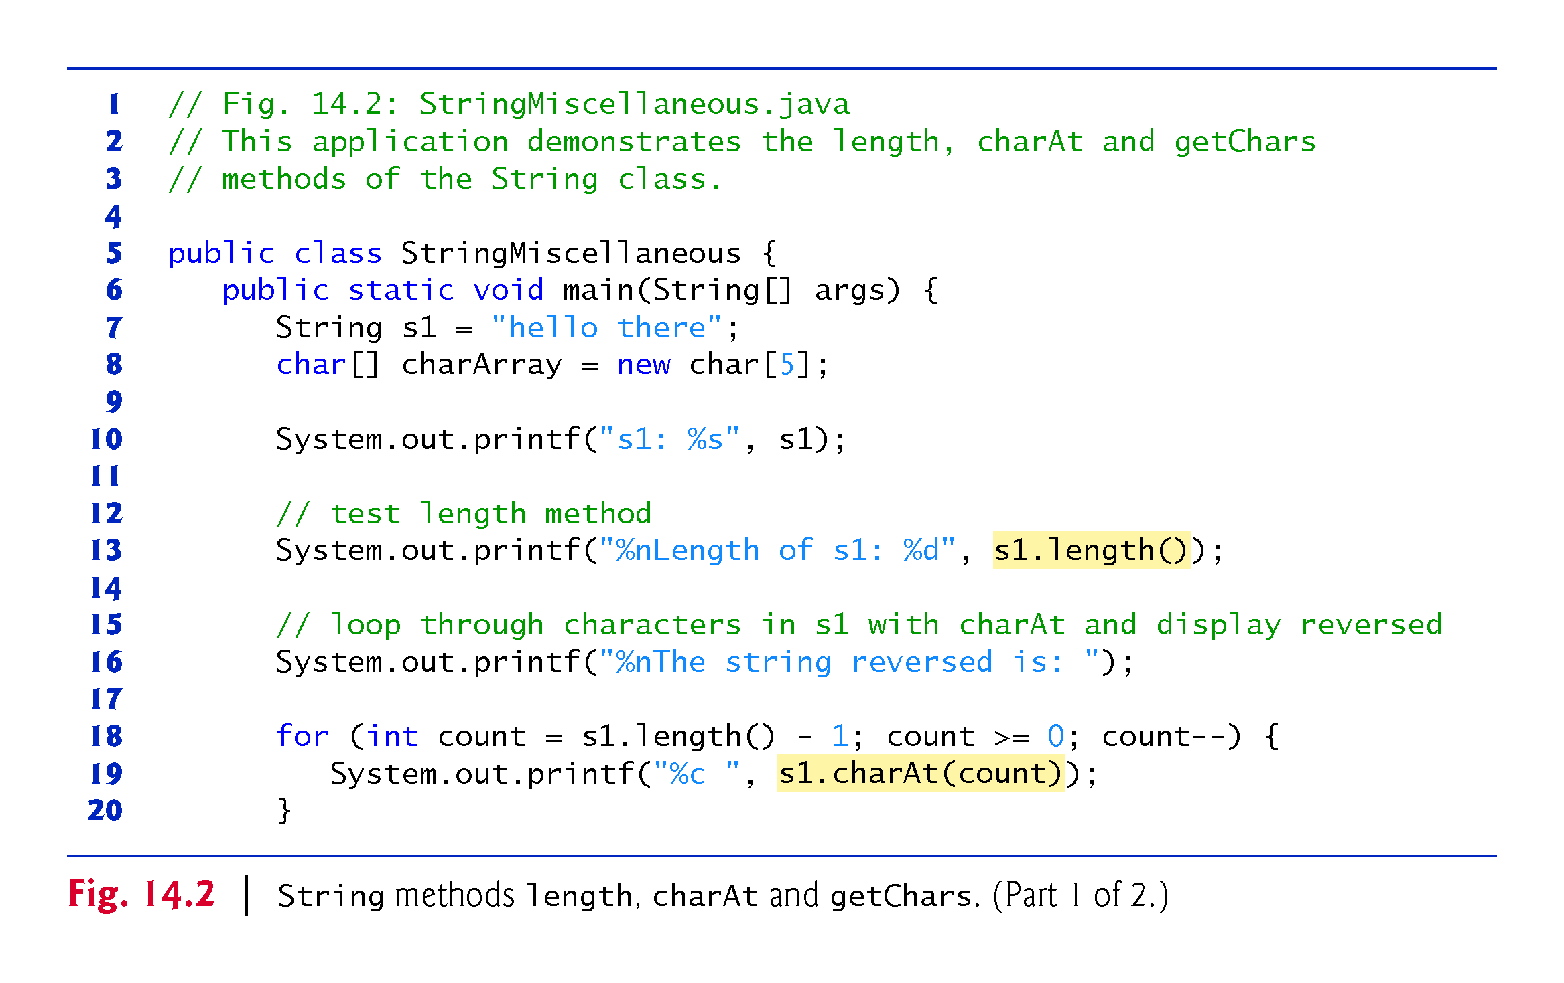

Slide 11
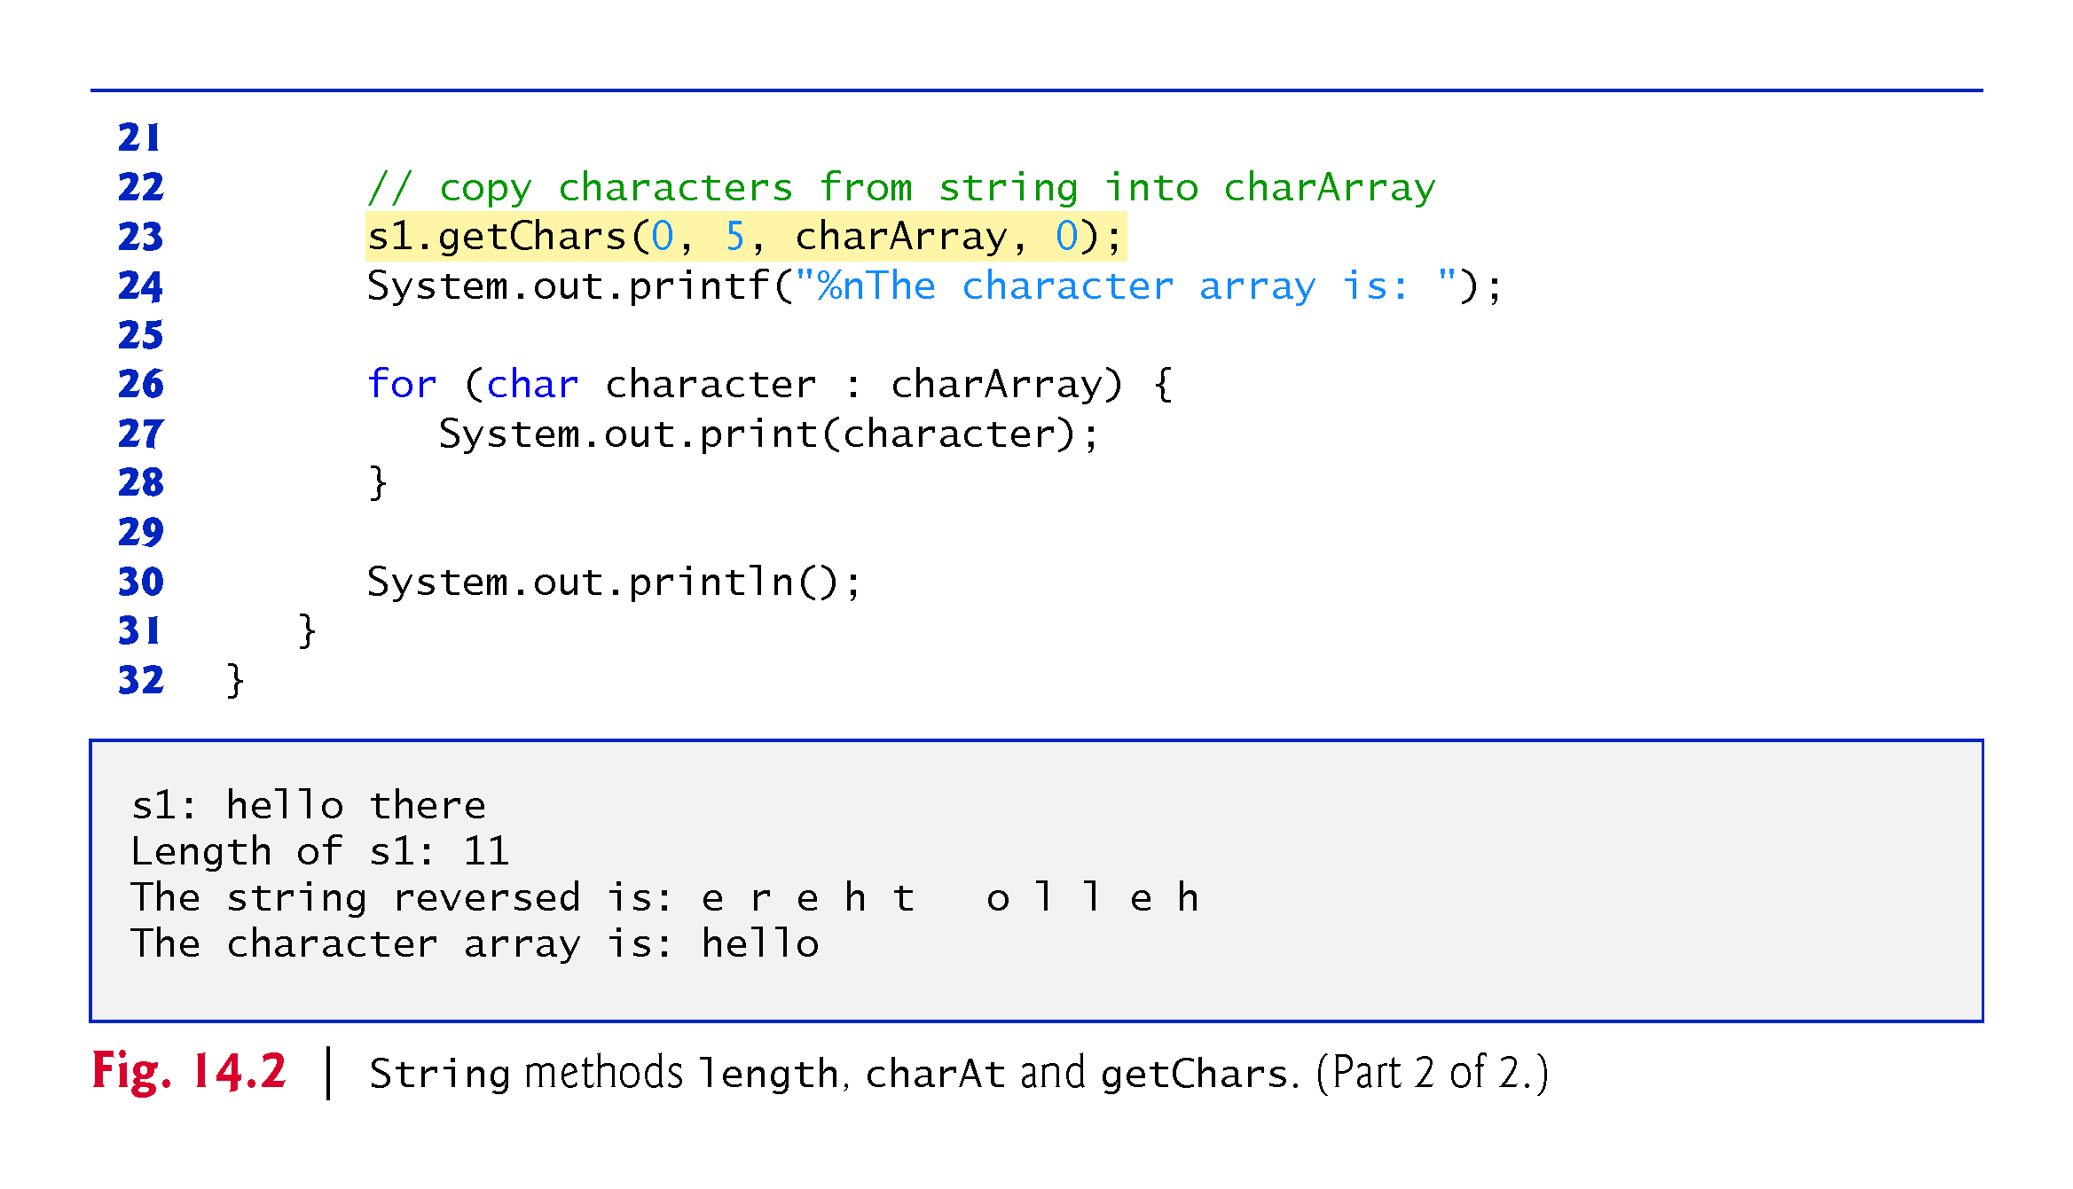

Slide 12
14.3.3 Comparing Strings
Strings are compared using the numeric codes of the characters in the strings.
Figure 14.3 demonstrates String methods equals, equalsIgnoreCase, compareTo and regionMatches and using the equality operator == to compare String objects.

Slide 13
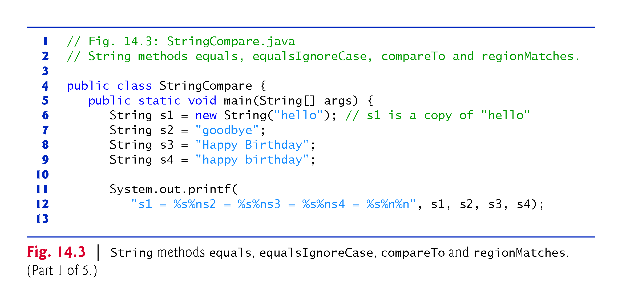

Slide 14
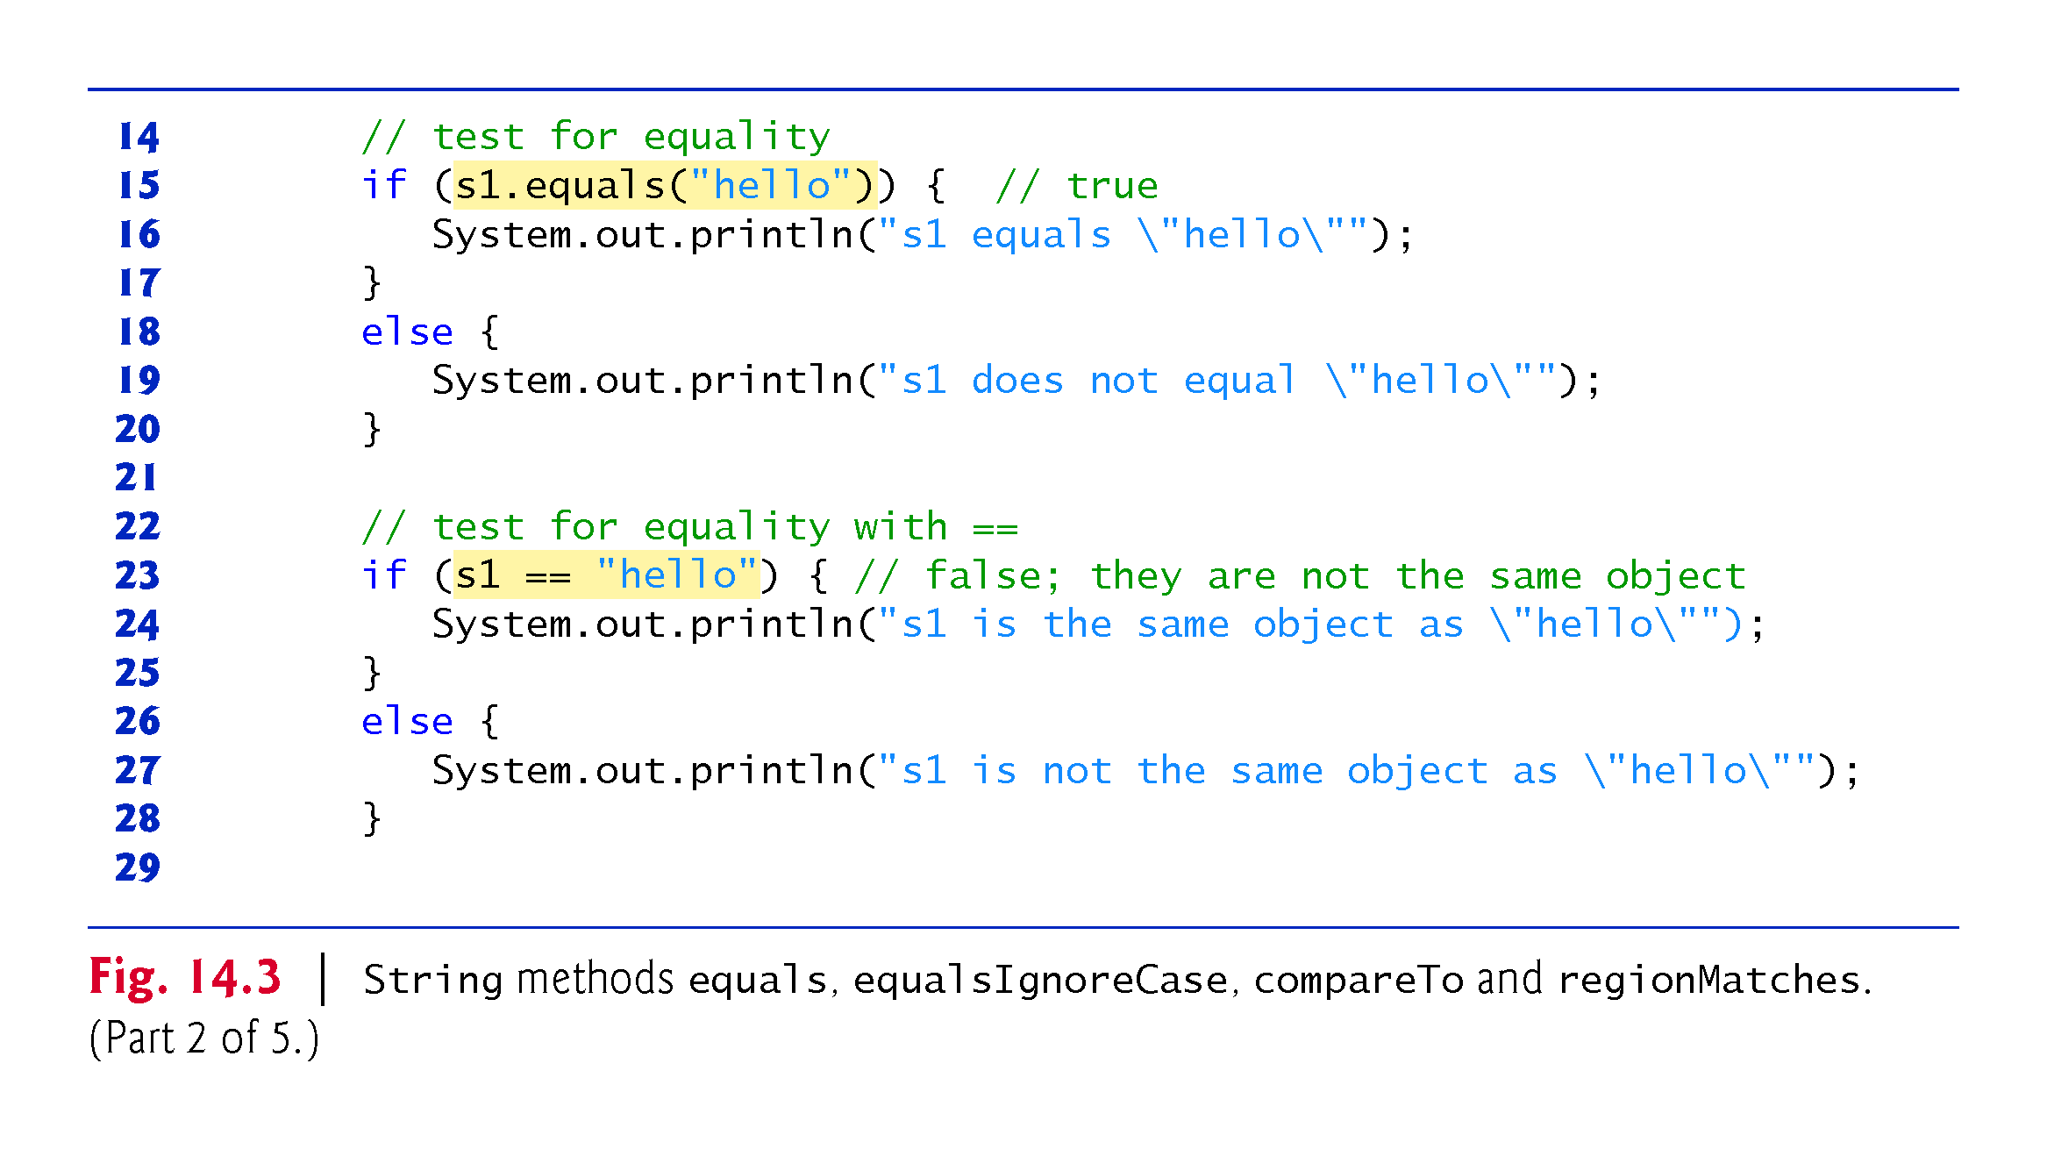

Slide 15
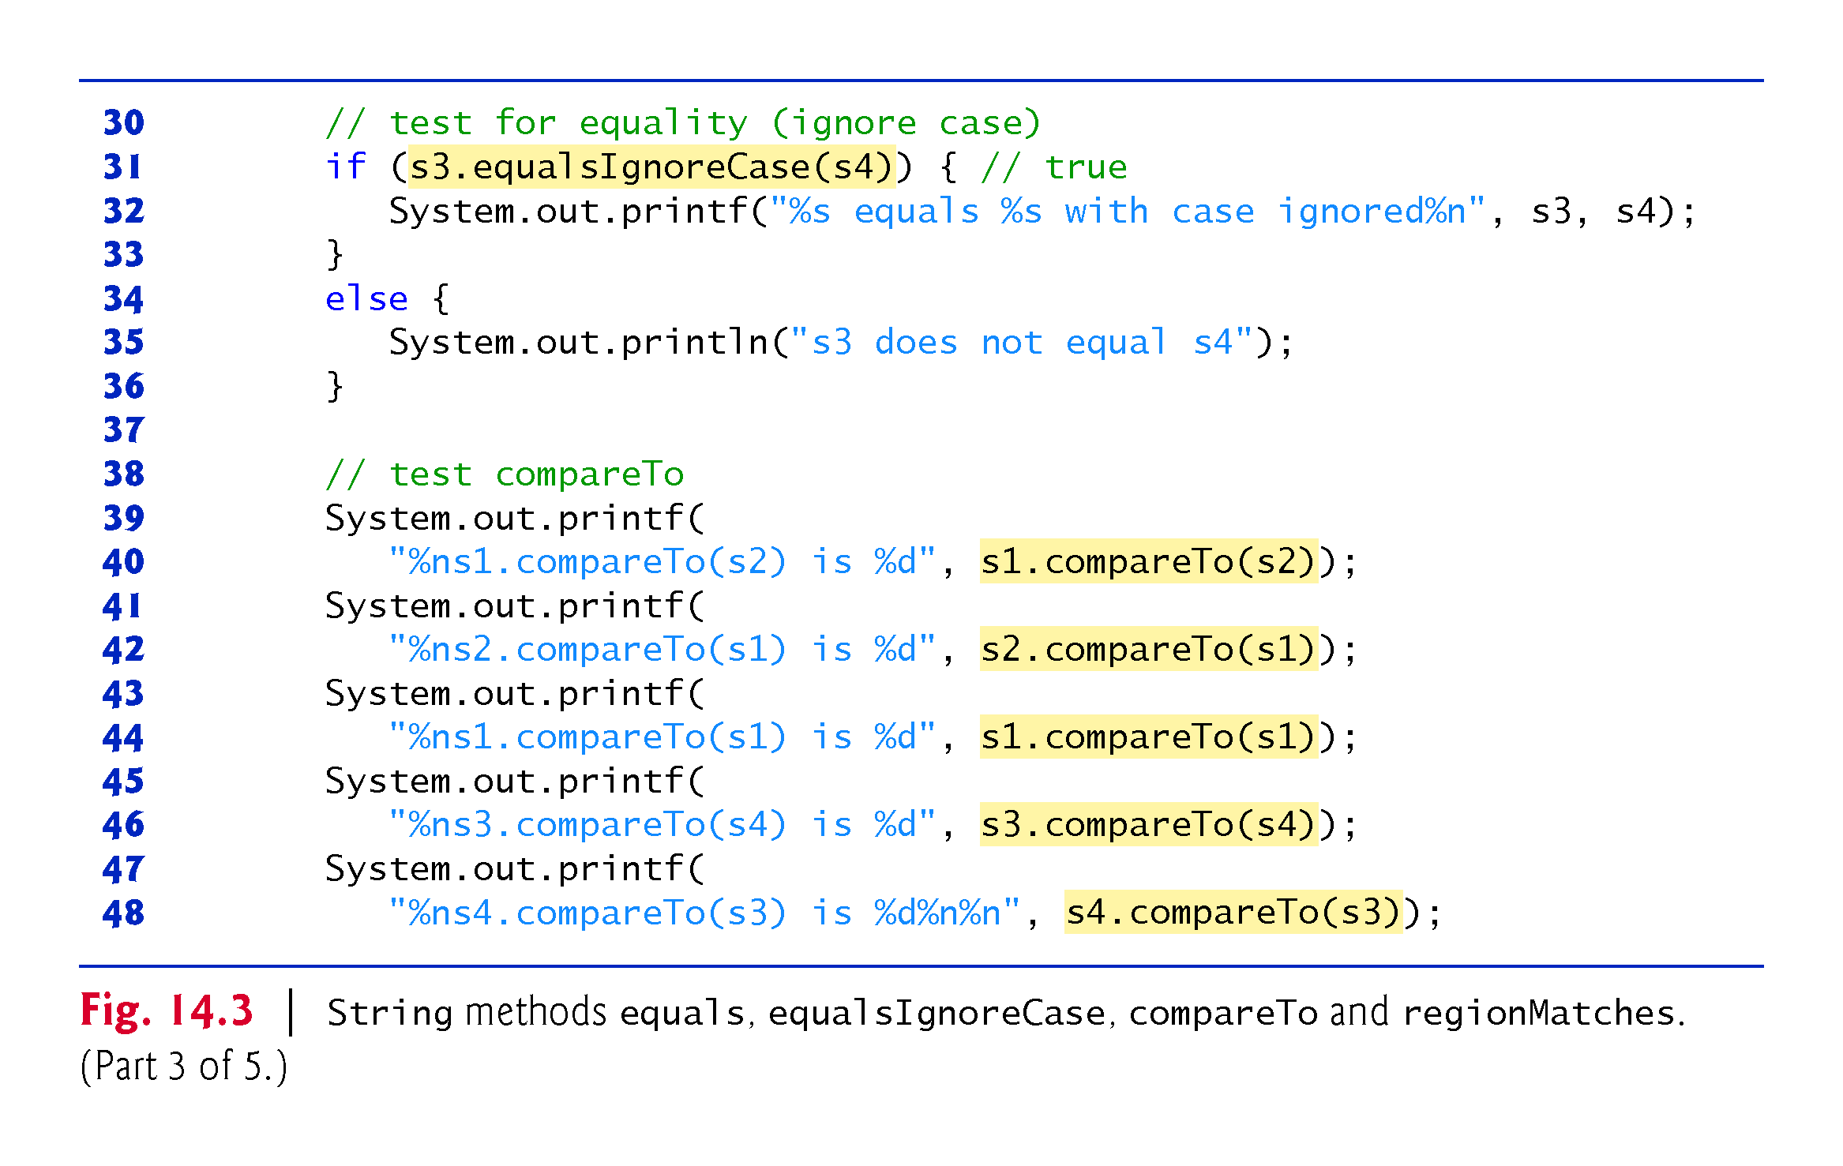

Slide 16
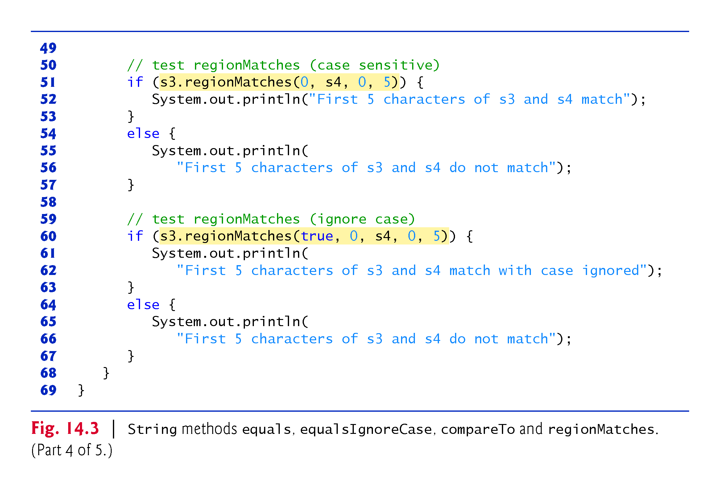

Slide 17
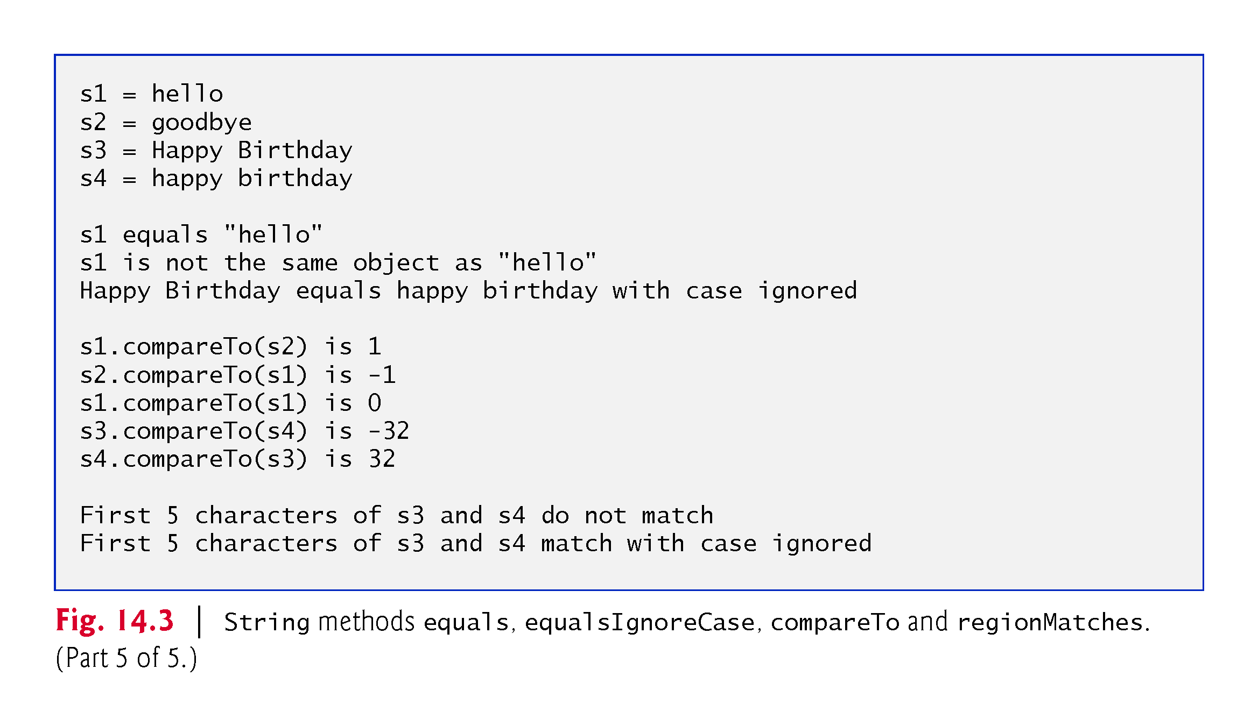

Slide 18
14.3.3 Comparing Strings (Cont.)
Strings are compared using the numeric codes of the characters in the strings.
Figure 14.4 demonstrates String methods equals, equalsIgnoreCase, compareTo and regionMatches and using the equality operator == to compare String objects.

Slide 19
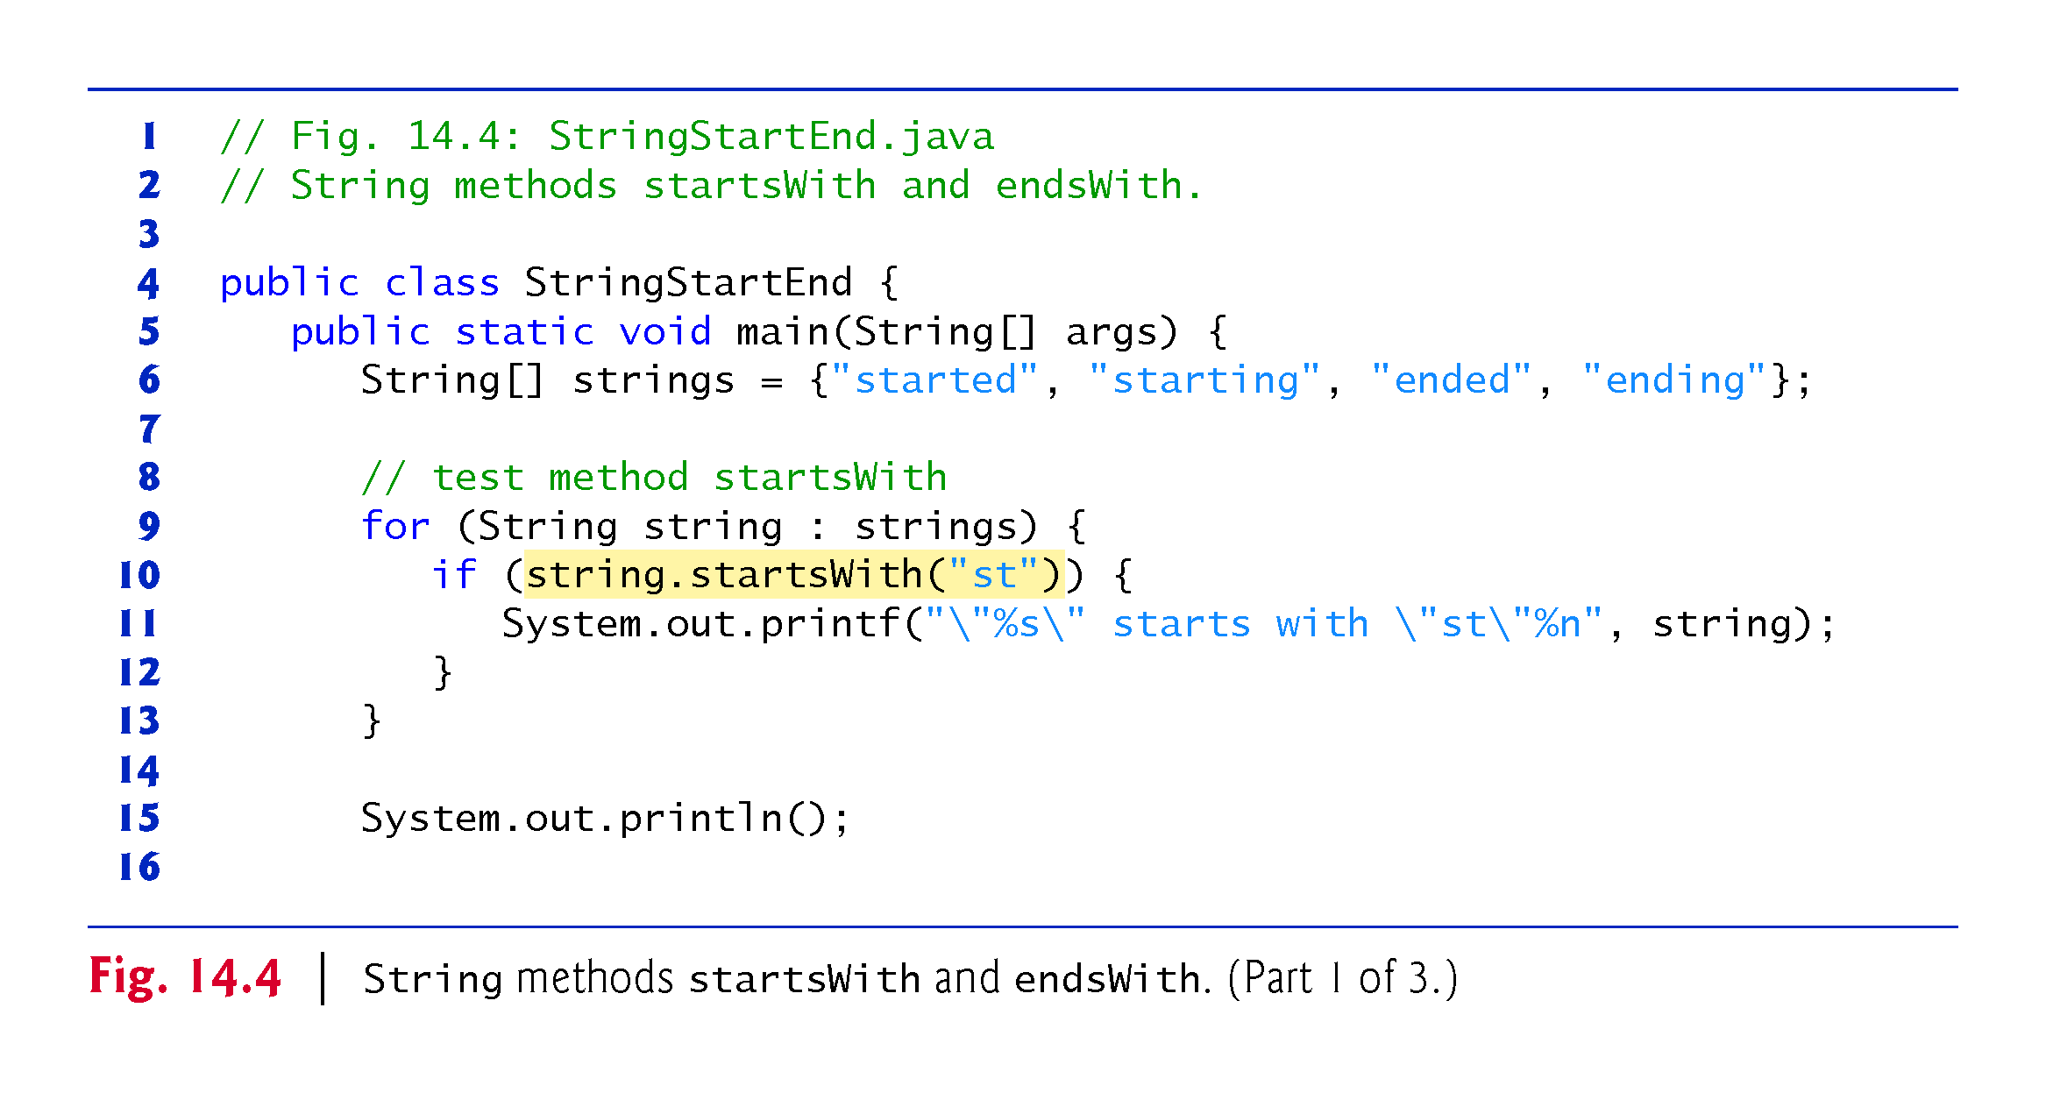

Slide 20
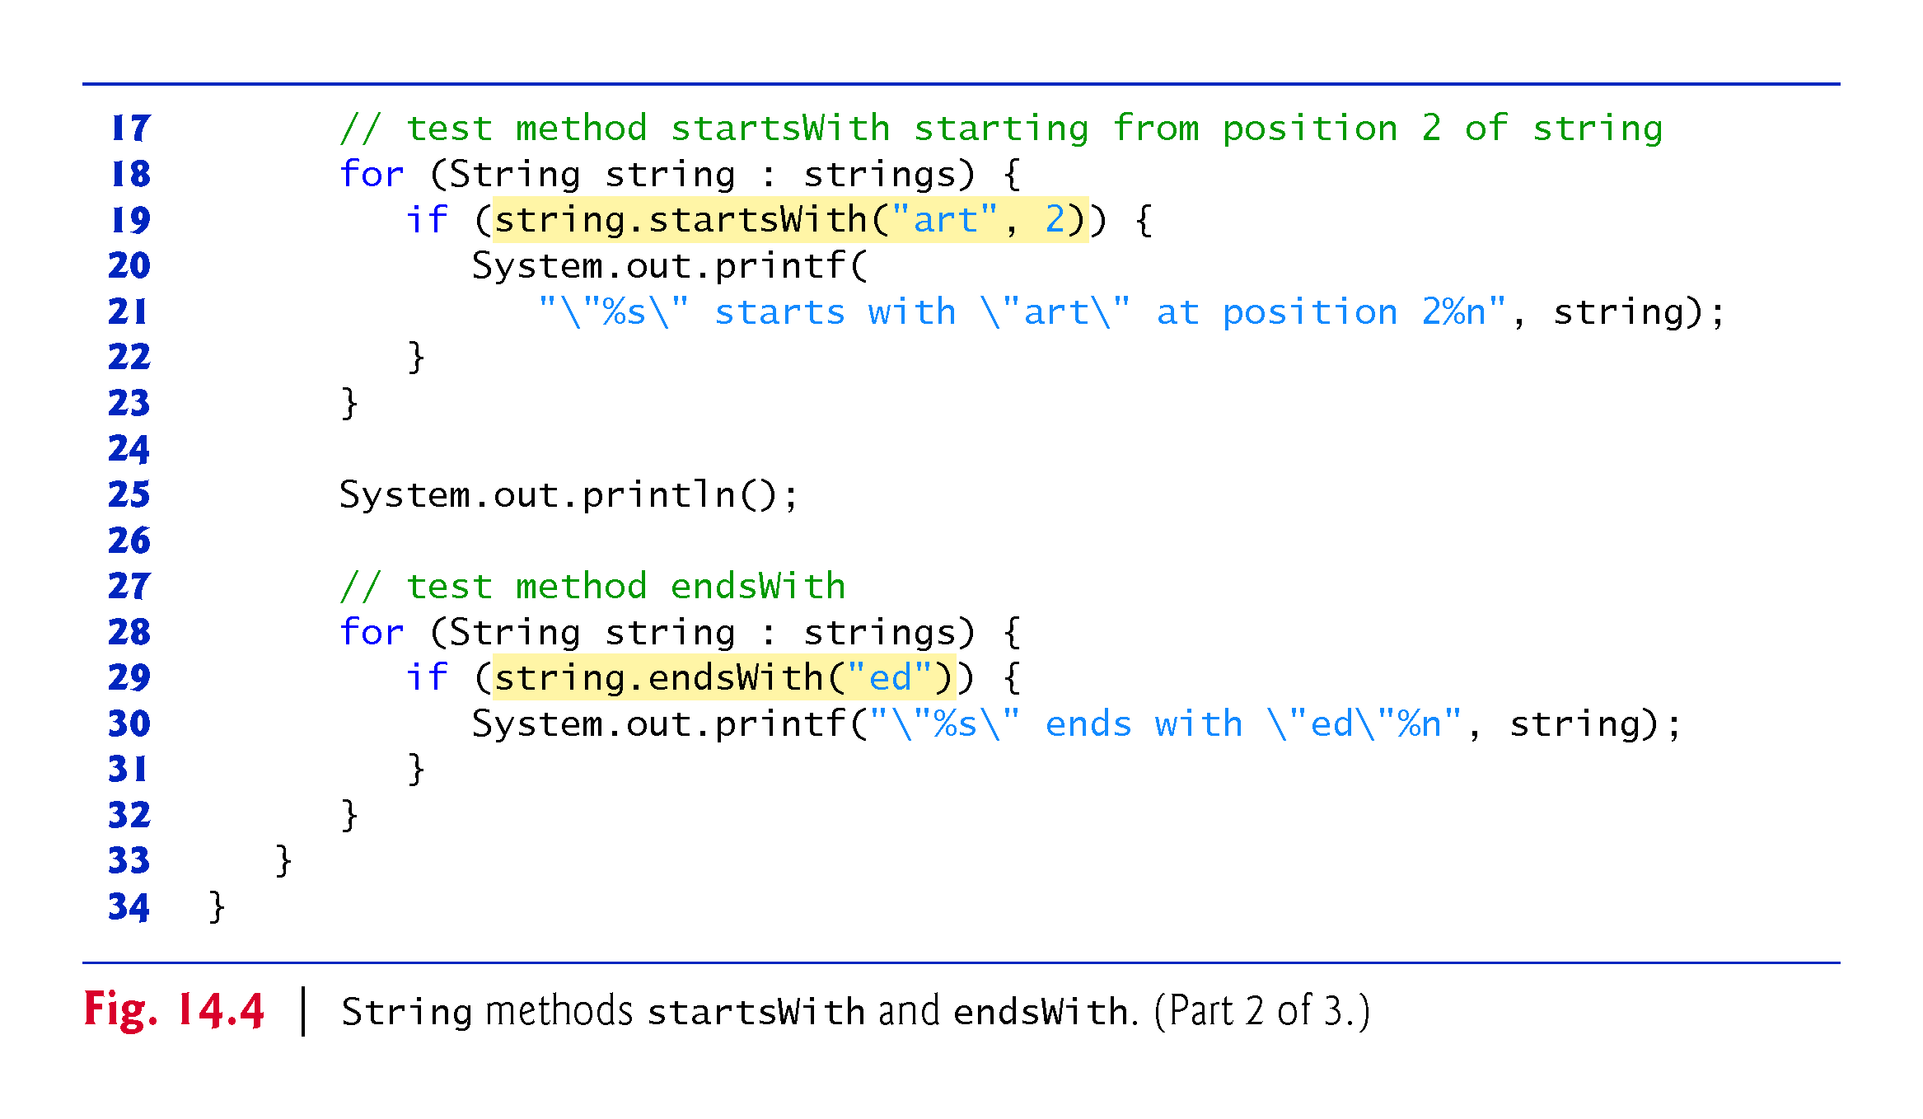

Slide 21
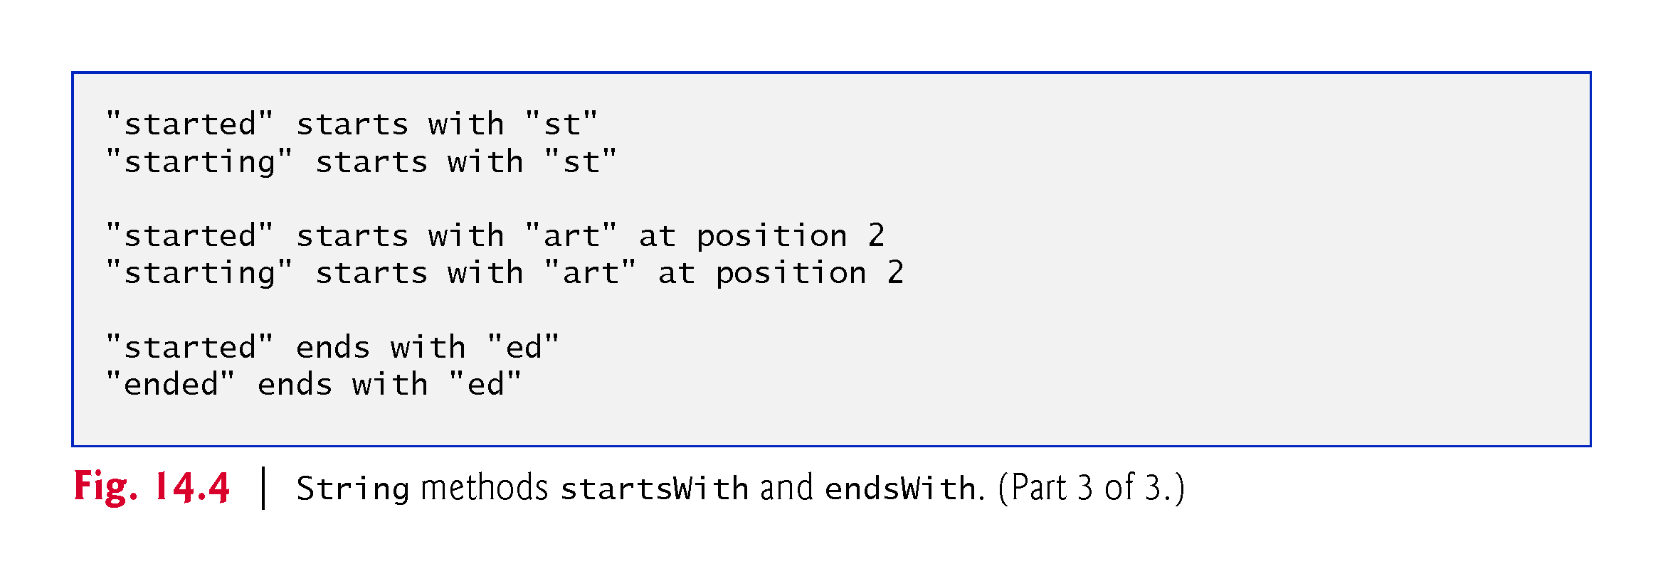

Slide 22
14.3.4 Locating Characters and Substrings in String
Figure 14.5 demonstrates the many versions of String methods indexOf and lastIndexOf that search for a specified character or substring in a String.

Slide 23
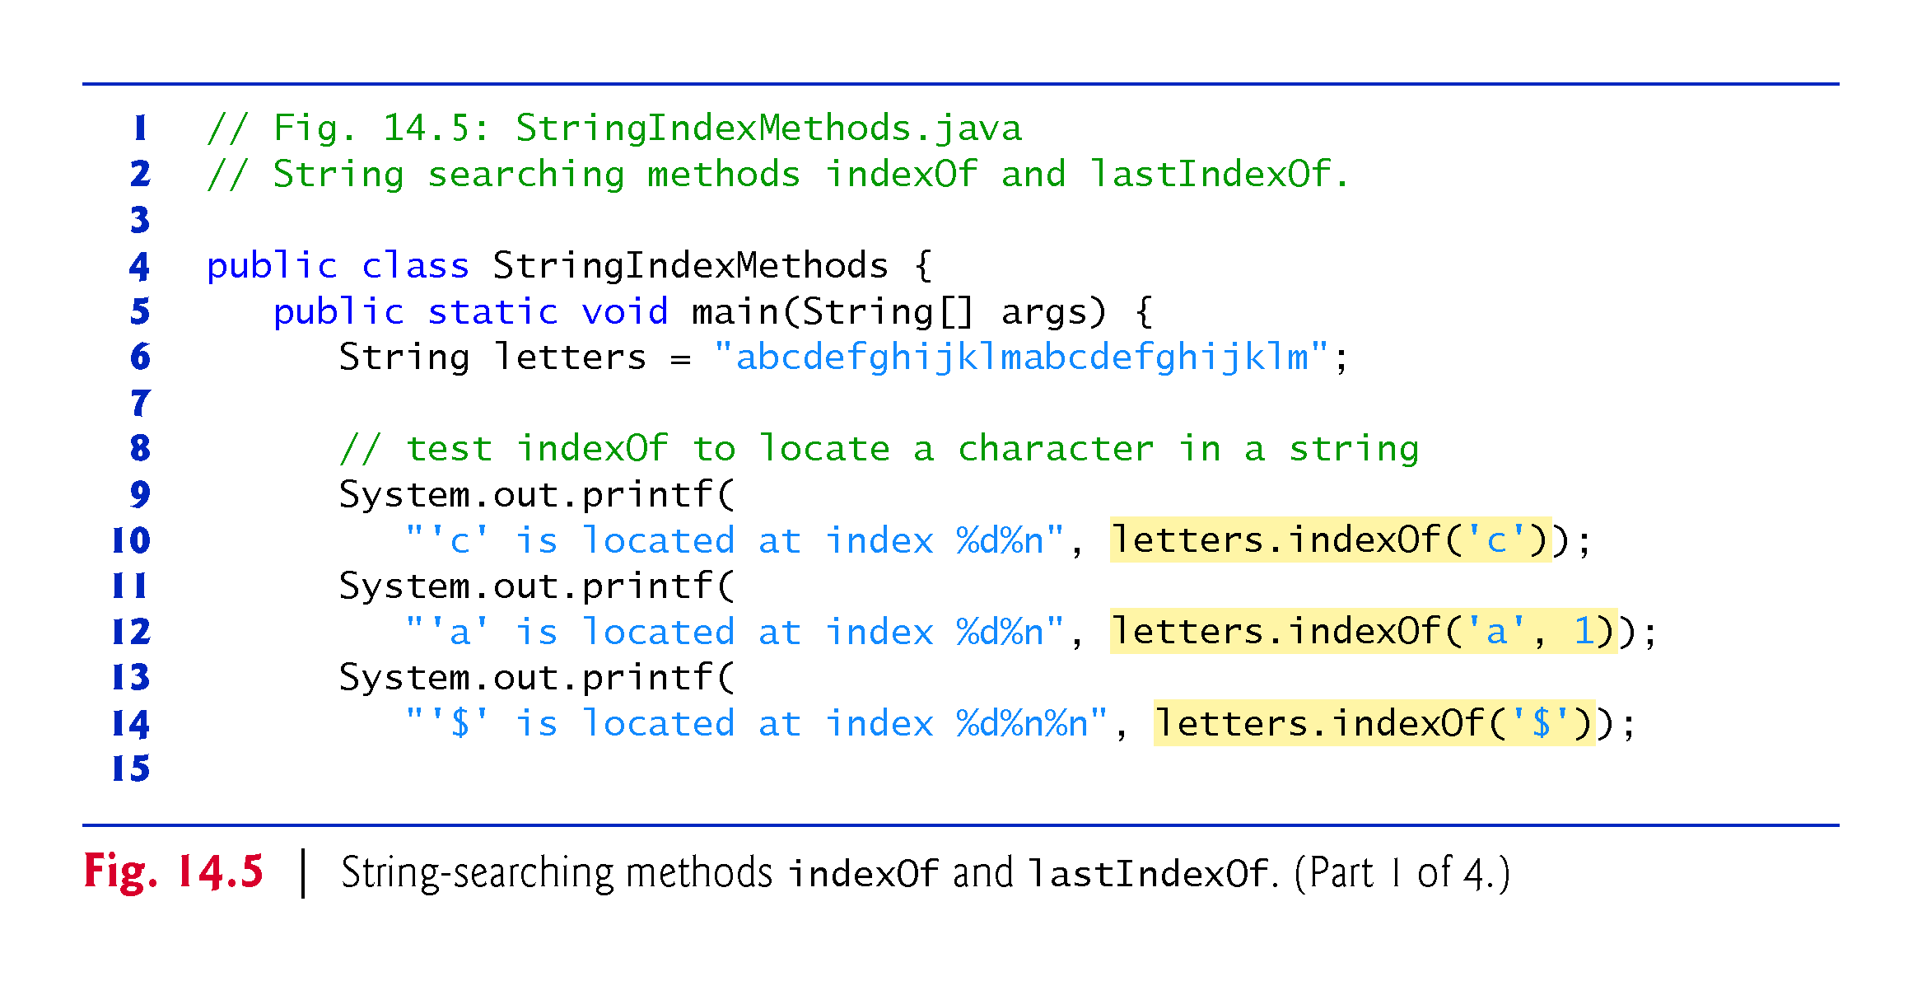

Slide 24
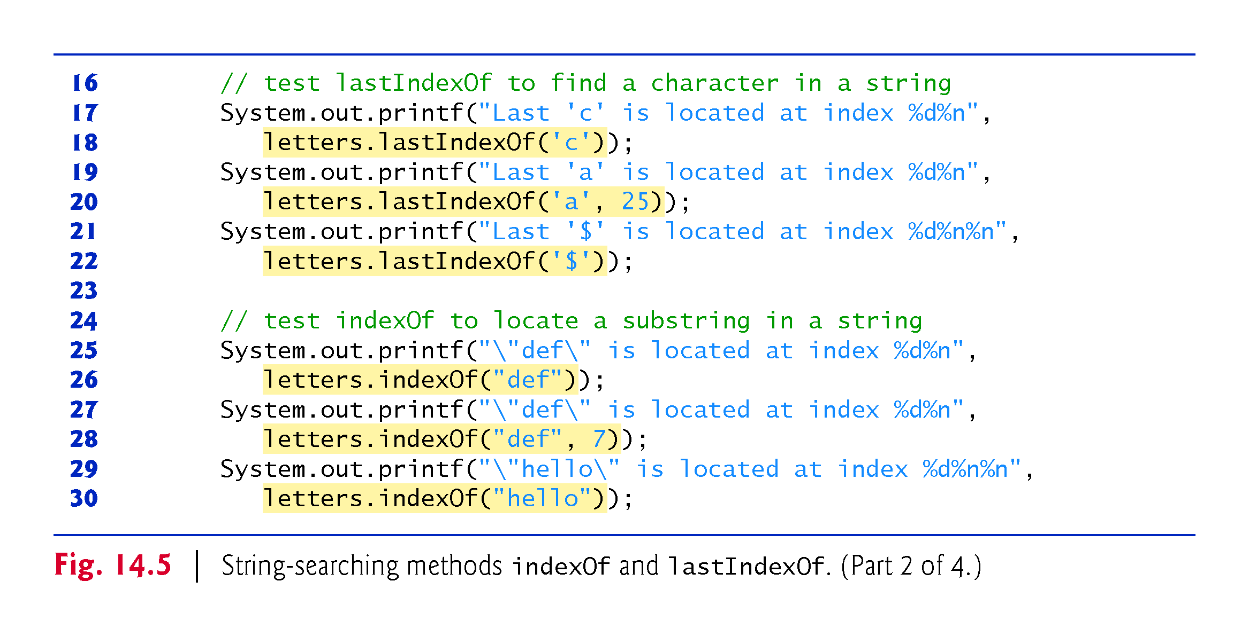

Slide 25
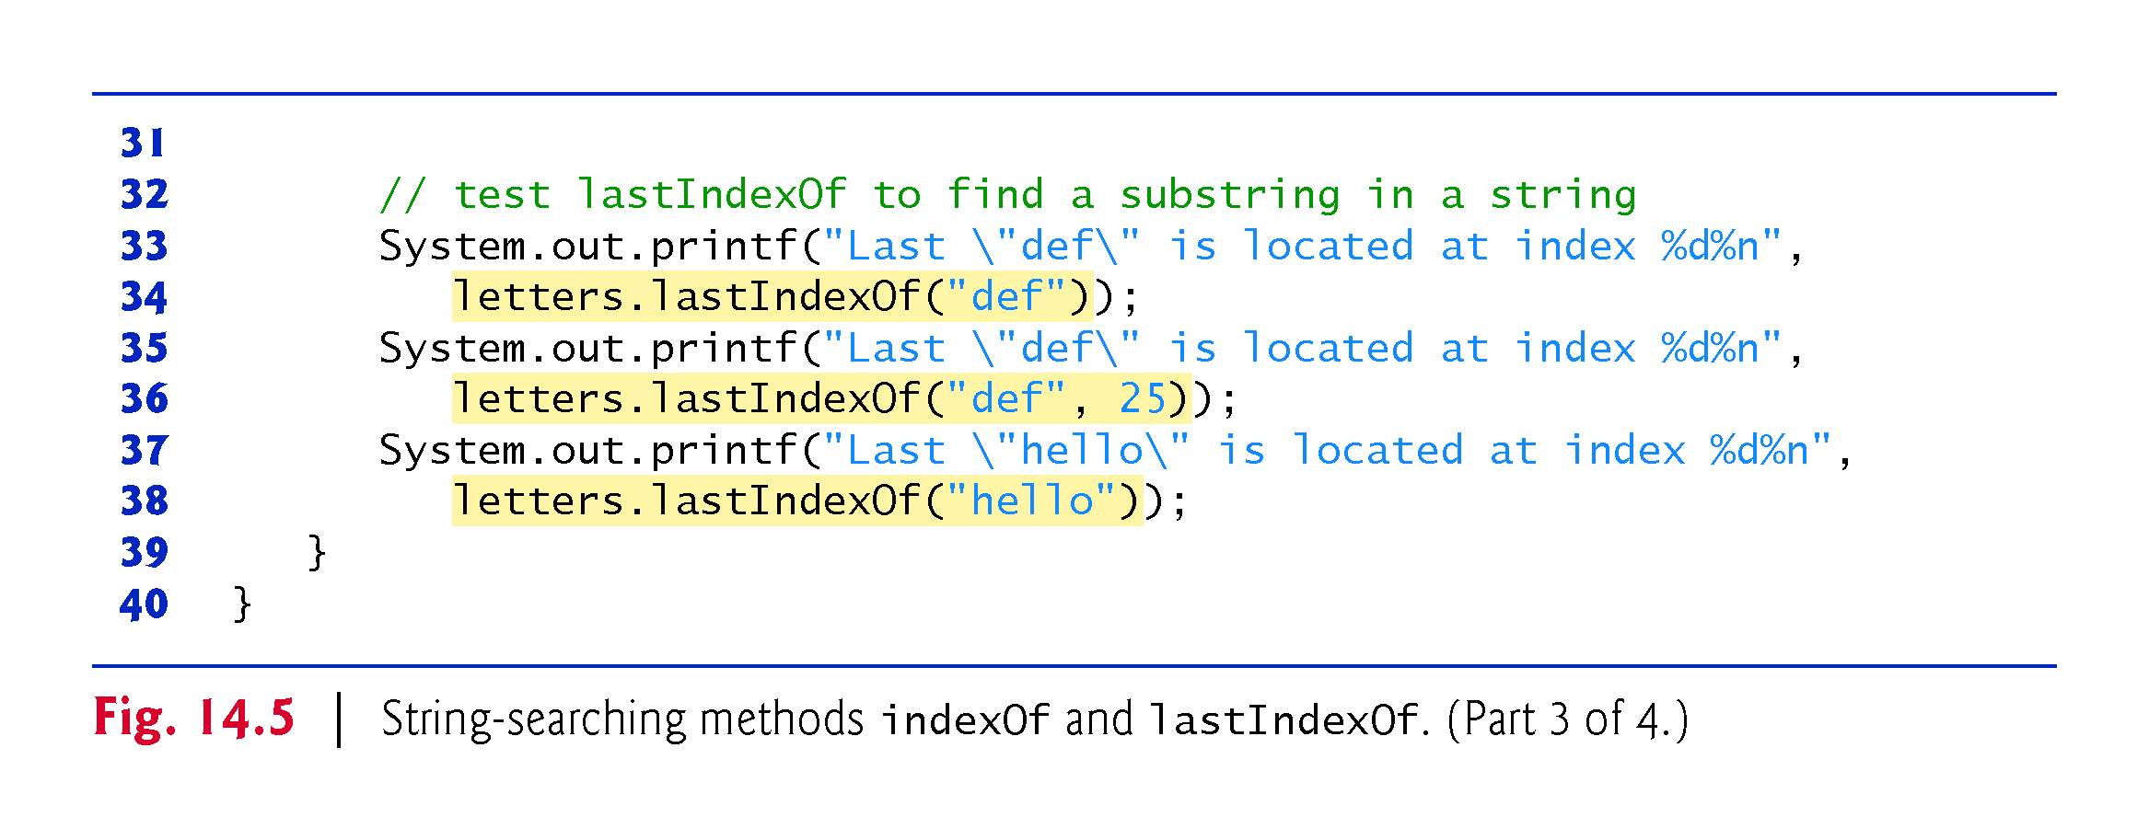

Slide 26
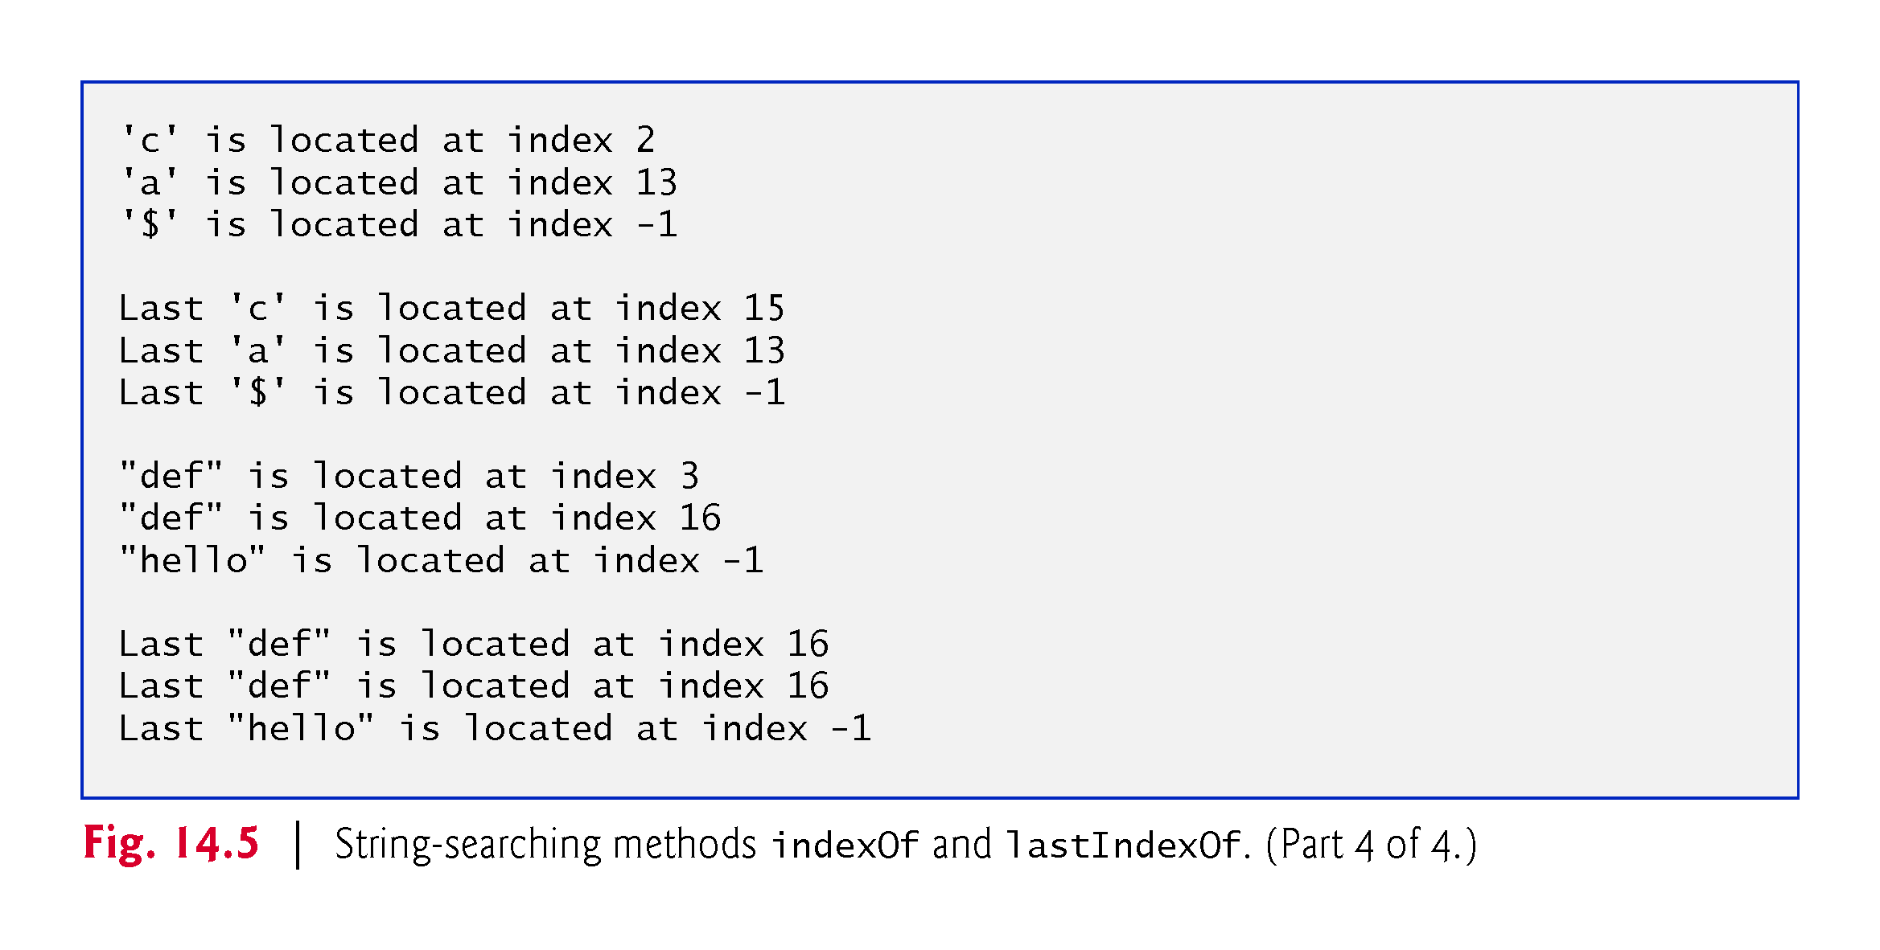

Slide 27
14.3.5 Extracting Substrings from Strings
Class String provides two substring methods to enable a new String object to be created by copying part of an existing String object. Each method returns a new String object.
The version that takes one integer argument specifies the starting index in the original String from which characters are to be copied.
The version that takes two integer arguments receives the starting index from which to copy characters in the original String and the index one beyond the last character to copy.

Slide 28
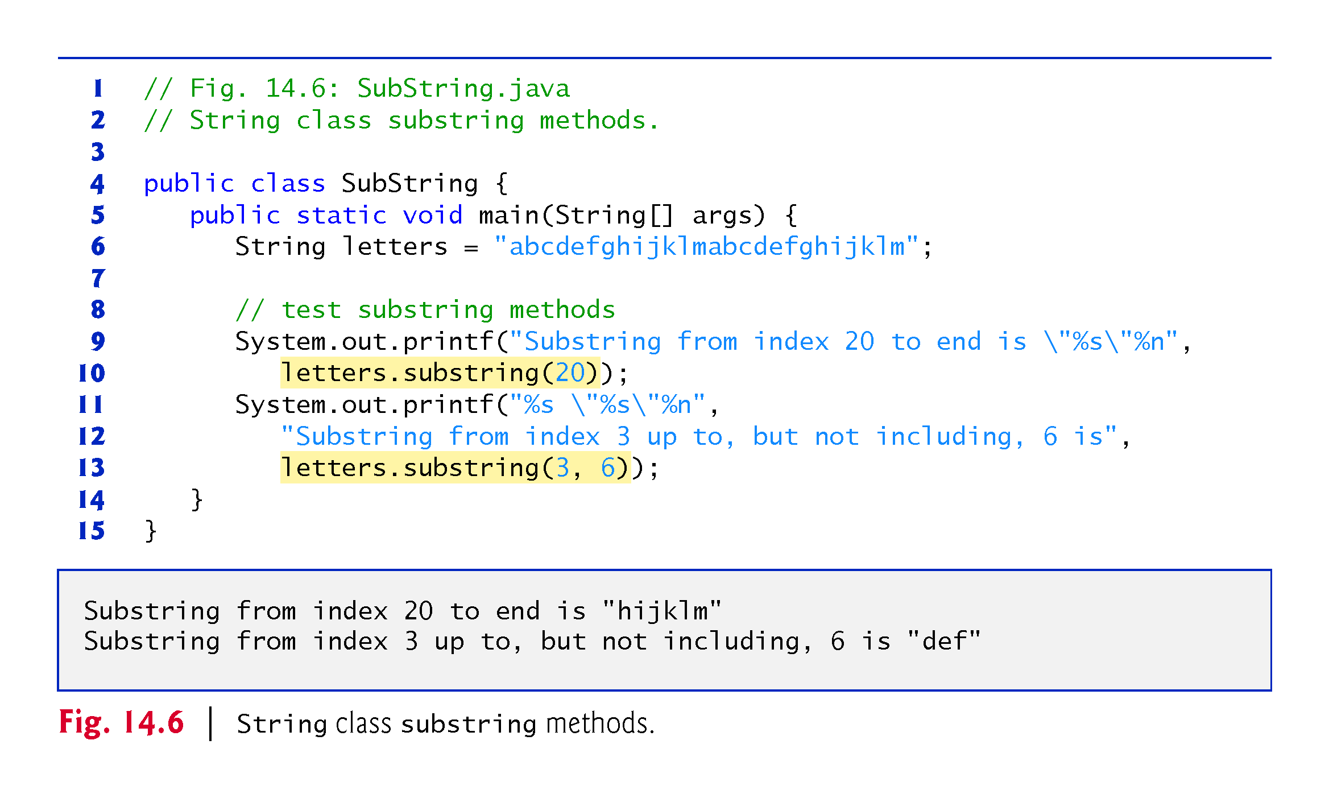

Slide 29
14.3.6 Concatenating Strings
String method concat concatenates two String objects (similar to using the + operator) and returns a new String object containing the characters from both original Strings.
The original Strings to which s1 and s2 refer are not modified.

Slide 30
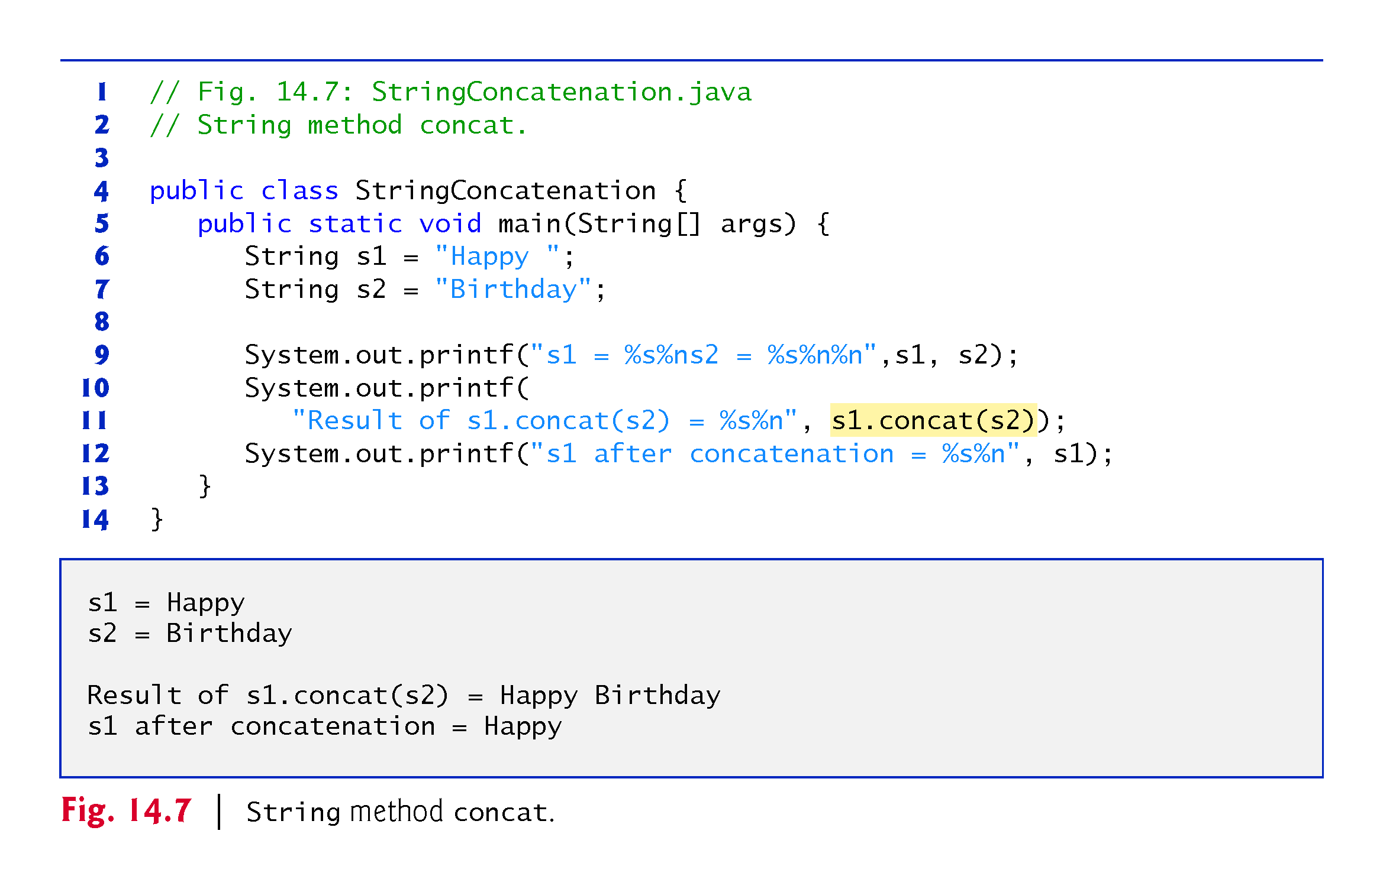

Slide 31
14.3.7 Miscellaneous String Methods
Method replace returns a new String object in which every occurrence of the first char argument is replaced with the second.
An overloaded version enables you to replace substrings rather than individual characters.
Method toUpperCase generates a new String with uppercase letters.
Method toLowerCase returns a new String object with lowercase letters.
Method trim generates a new String object that removes all whitespace characters that appear at the beginning or end of the String on which trim operates.
Method toCharArray creates a new character array containing a copy of the characters in the String.

Slide 32
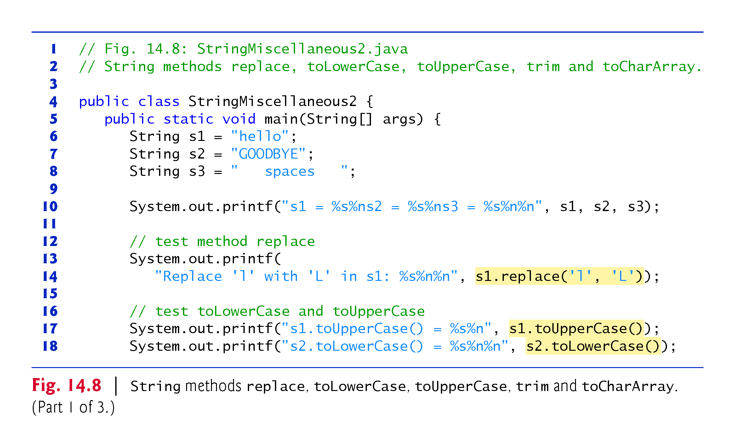

Slide 33
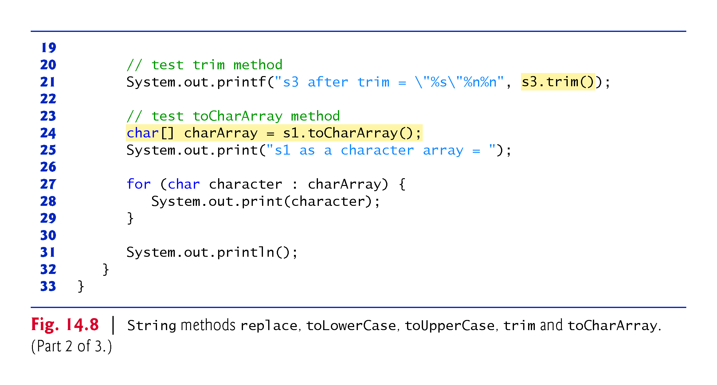

Slide 34
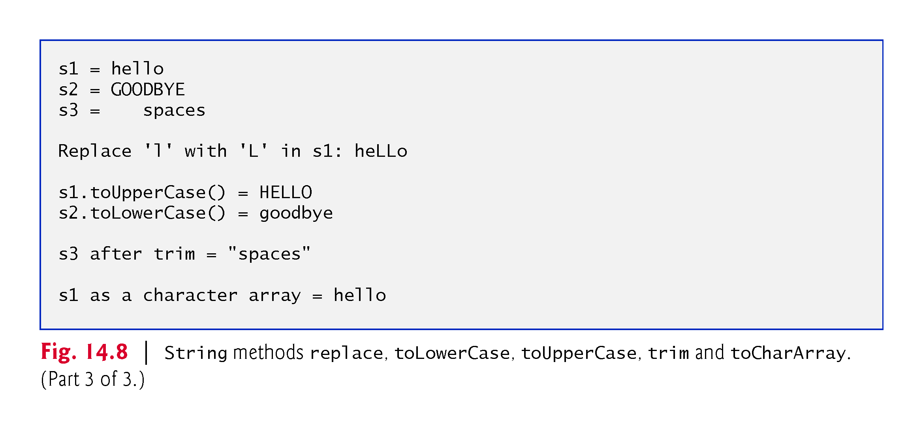

Slide 35
14.3.8 String Method valueOf
Class String provides static valueOf methods that take an argument of any type and convert it to a String object.

Slide 36
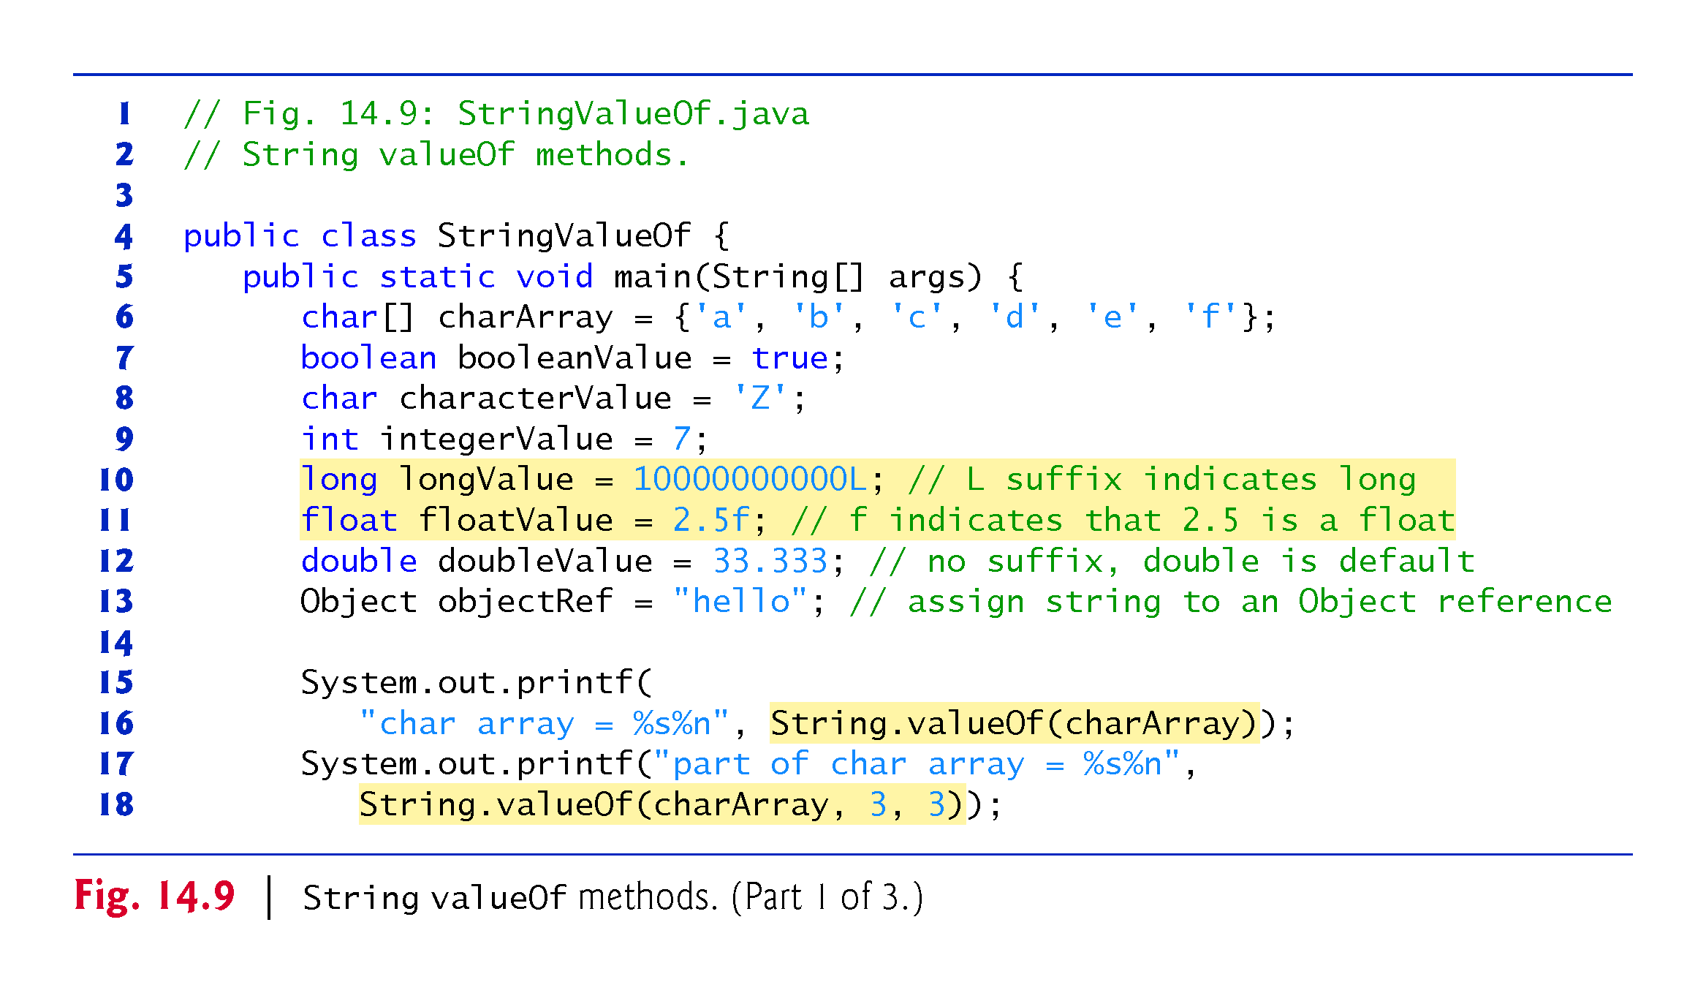

Slide 37
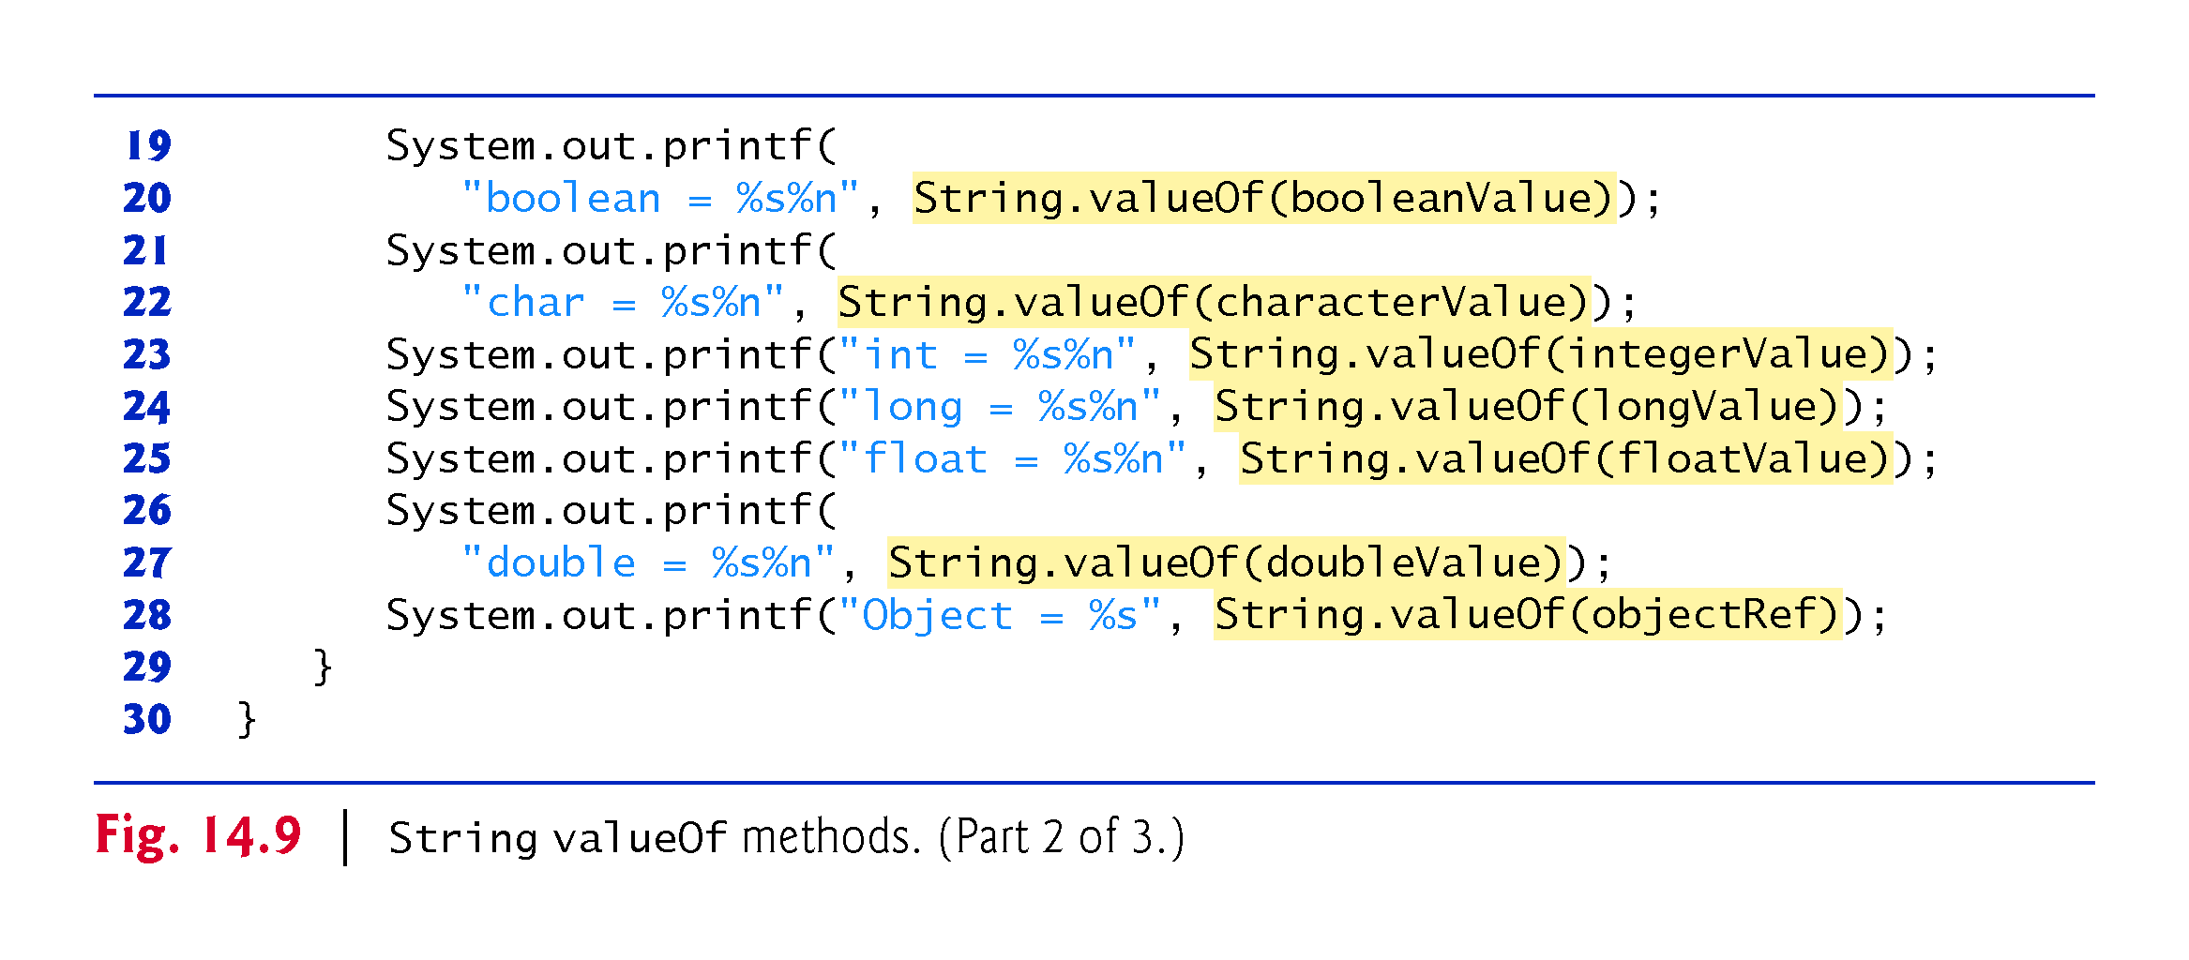

Slide 38
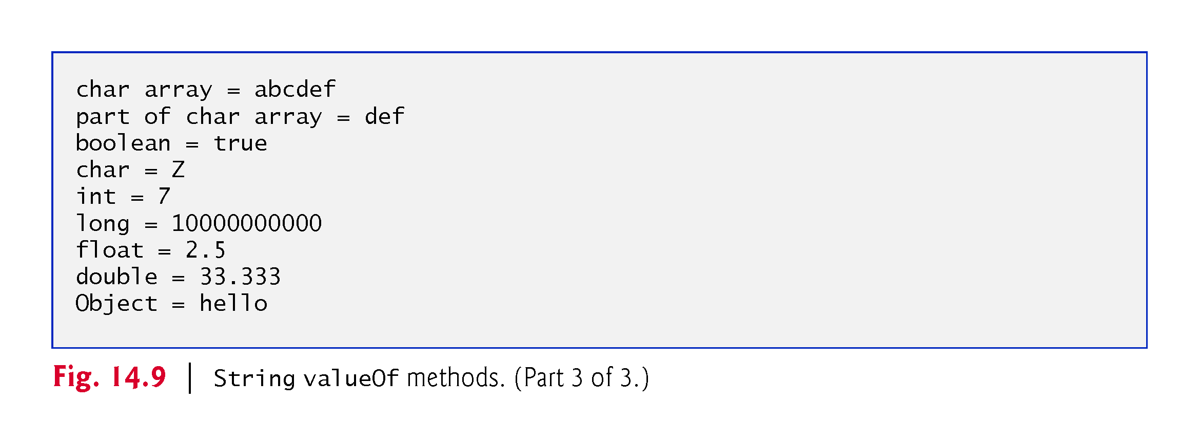

Slide 39
14.4 Class StringBuilder
We now discuss the features of class StringBuilder for creating and manipulating dynamic string information—that is, modifiable strings.
Every StringBuilder is capable of storing a number of characters specified by it’s capacity.
If a StringBuilder‘s capacity is exceeded, the capacity expands to accommodate additional characters.

Slide 40
14.4.1 StringBuilder Constructor
No-argument constructor creates a StringBuilder with no characters in it and an initial capacity of 16 characters.
Constructor that takes an integer argument creates a StringBuilder with no characters in it and the initial capacity specified by the integer argument.
Constructor that takes a String argument creates a StringBuilder containing the characters in the String argument. The initial capacity is the number of characters in the String argument plus 16.
Method toString of class StringBuilder returns the StringBuilder contents as a String.

Slide 41
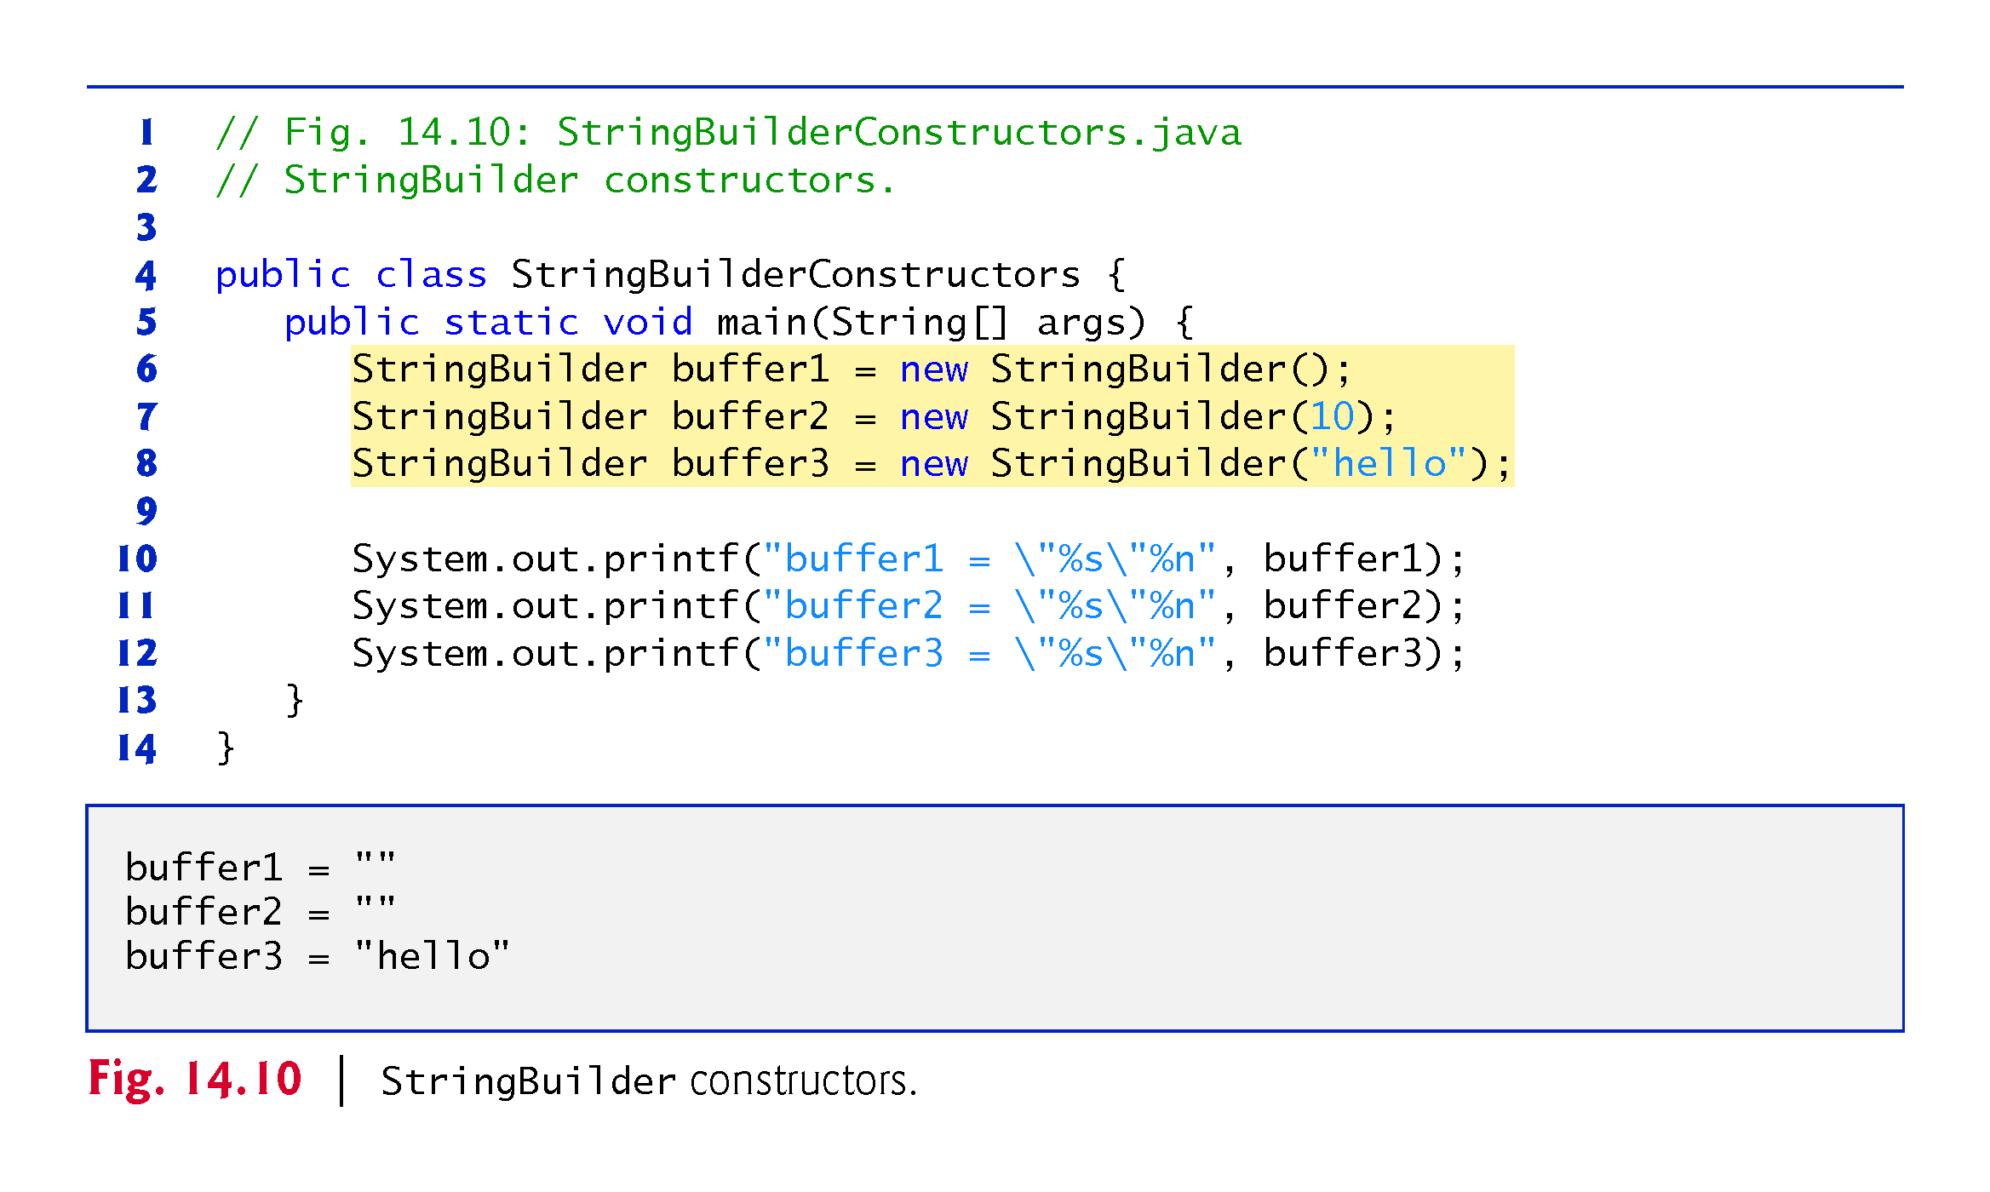

Slide 42
14.4.2 StringBuilder Methods length, capacity, setLength and ensureCapacity
Methods length and capacity return the number of characters currently in a StringBuilder and the number of characters that can be stored in a without allocating more memory, respectively.
Method ensureCapacity guarantees that a StringBuilder has at least the specified capacity.
Method setLength increases or decreases the length of a StringBuilder.
If the specified length is less than the current number of characters, the buffer is truncated to the specified length.
If the specified length is greater than the number of characters, null characters are appended until the total number of characters in the StringBuilder is equal to the specified length.

Slide 43
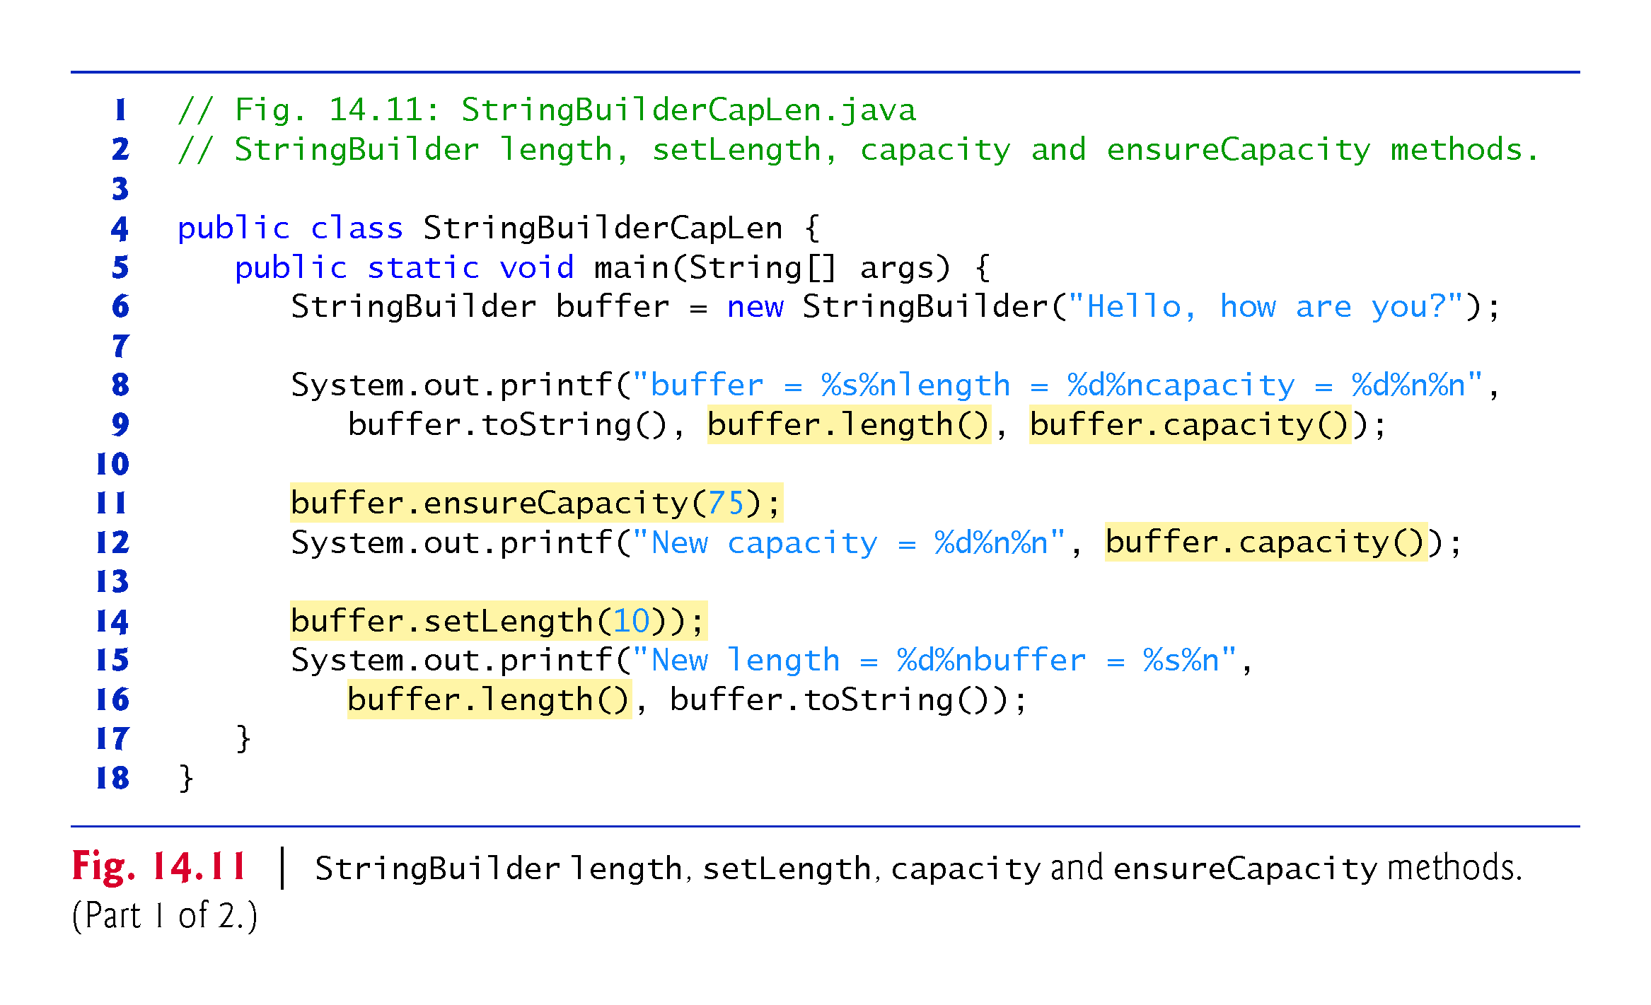

Slide 44
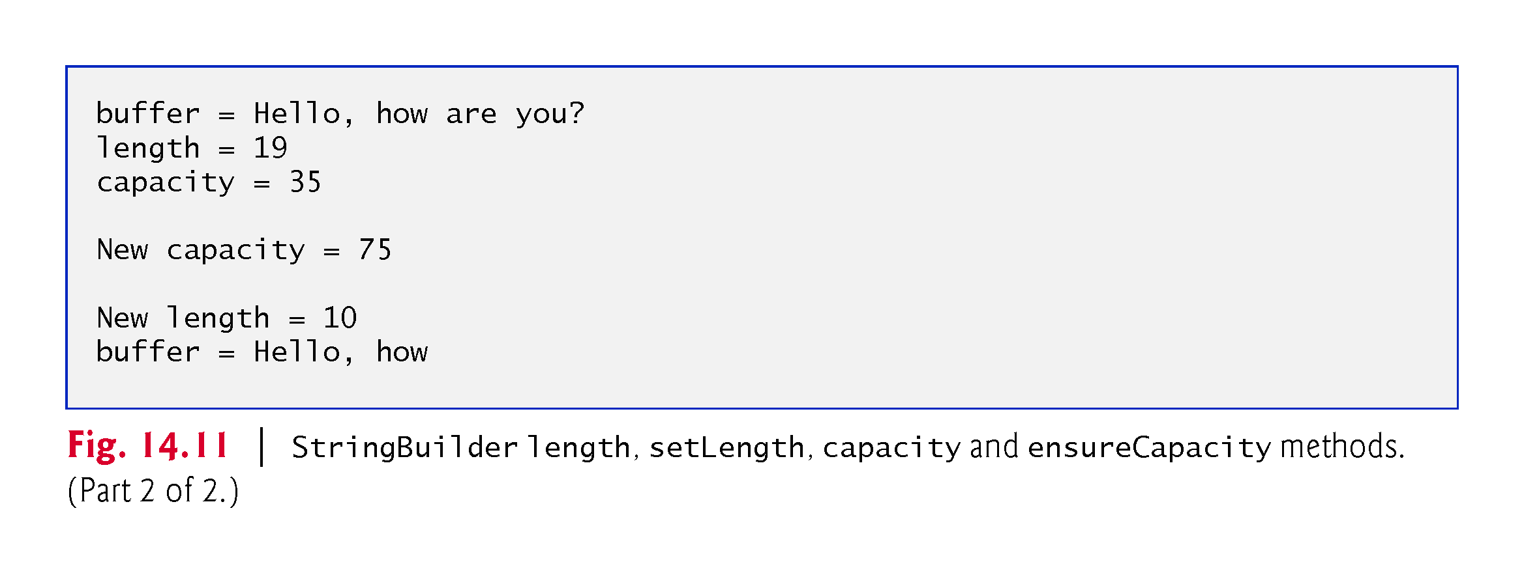

Slide 45
14.4.3 StringBuilder Methods CharAt, setCharAt, getChars and reverse
Method charAt takes an integer argument and returns the character in the StringBuilder at that index.
Method getChars copies characters from a StringBuilder into the character array argument.
Four arguments—the starting index from which characters should be copied, the index one past the last character to be copied, the character array into which the characters are to be copied and the starting location in the character array where the first character should be placed.
Method setCharAt takes an integer and a character argument and sets the character at the specified position in the StringBuilder to the character argument.
Method reverse reverses the contents of the StringBuilder.

Slide 46
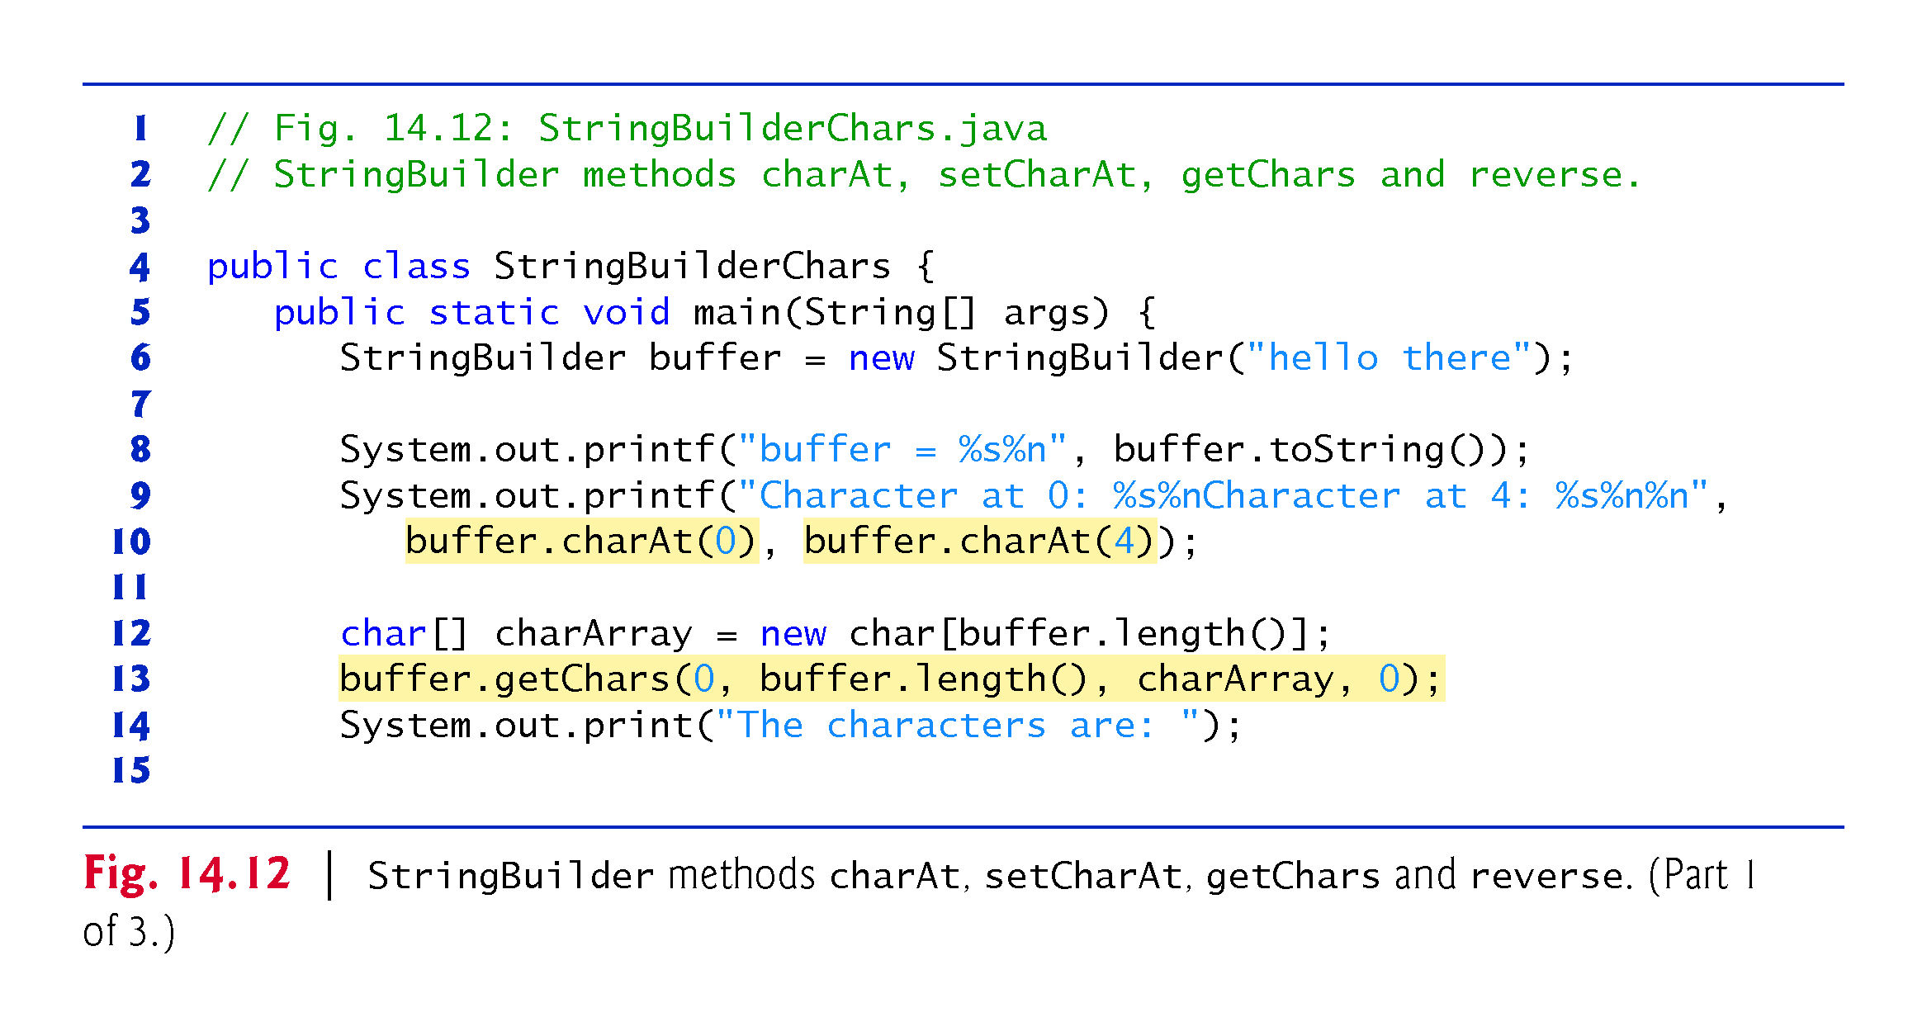

Slide 47
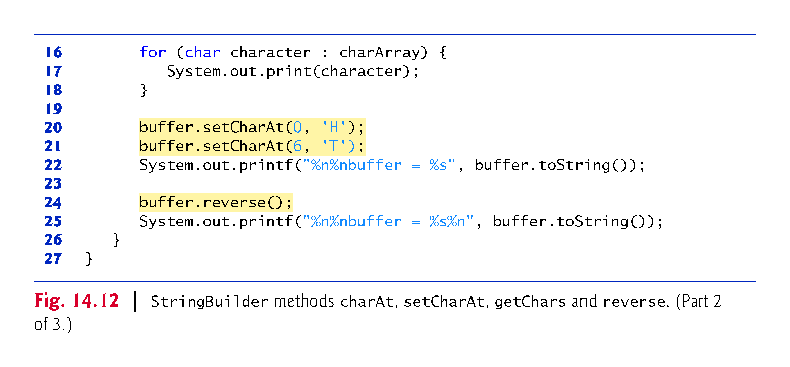

Slide 48
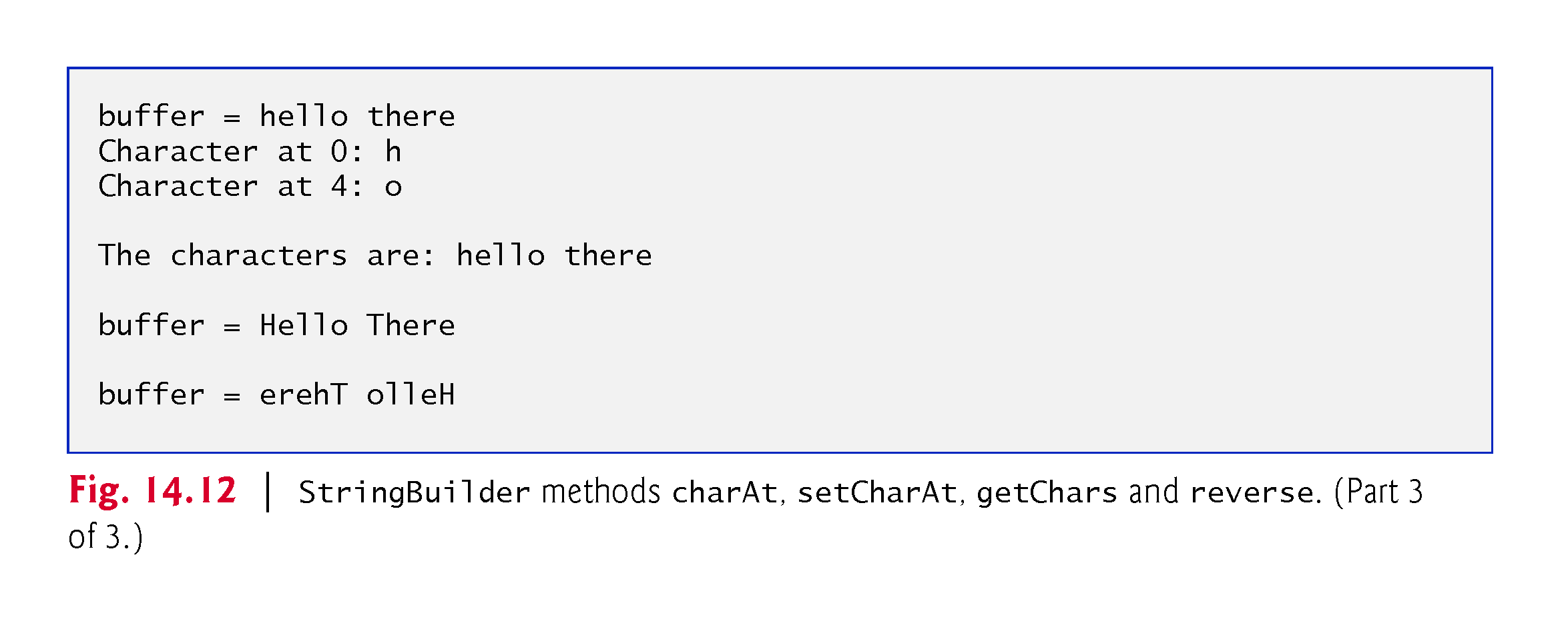

Slide 49
14.4.4 StringBuilder append Methods
Overloaded append methods allow values of various types to be appended to the end of a StringBuilder.
Versions are provided for each of the primitive types and for character arrays, Strings, Objects, and more.

Slide 50
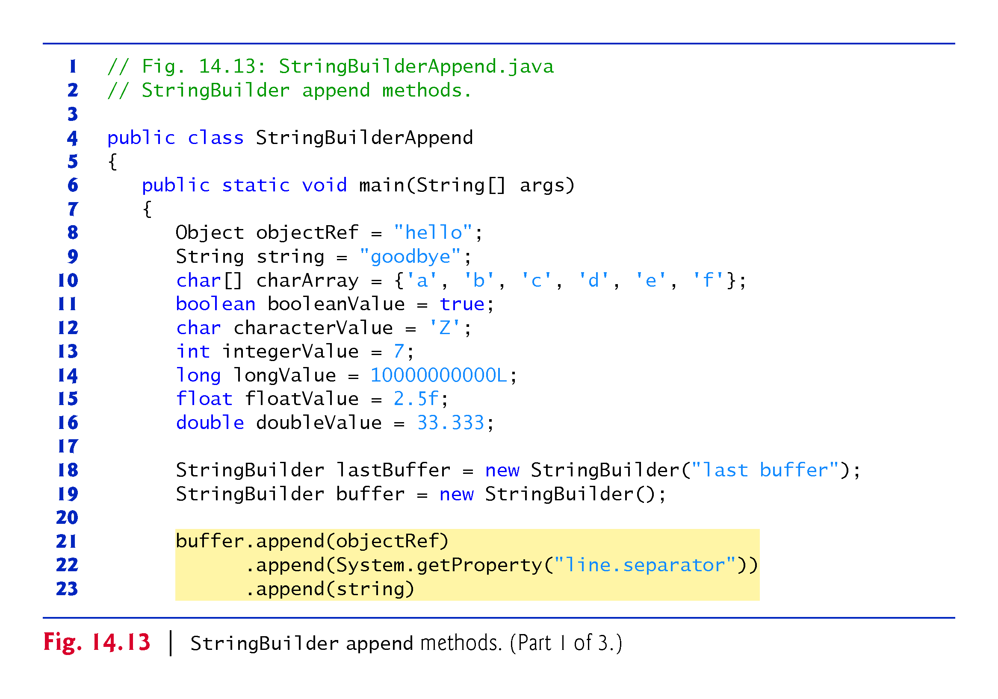

Slide 51
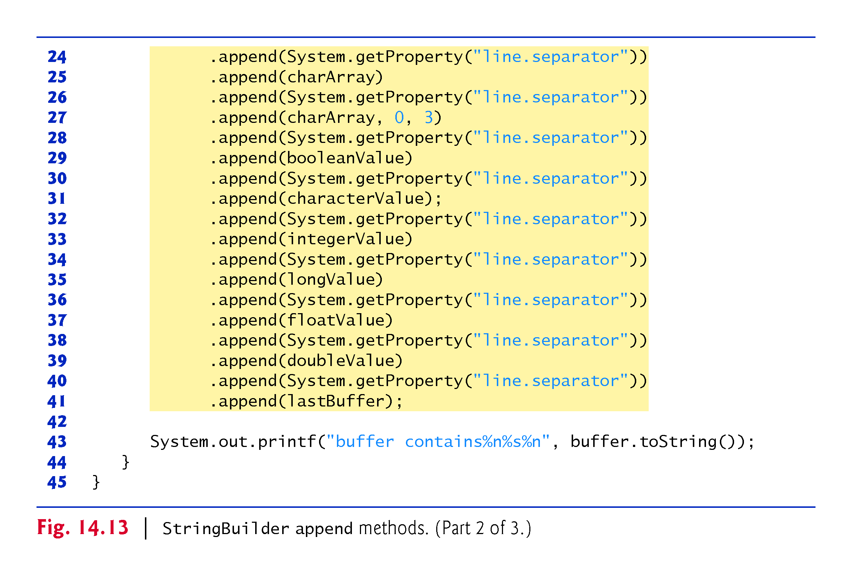

Slide 52
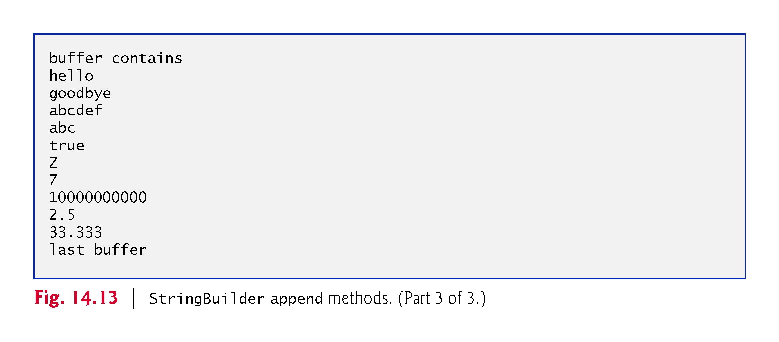

Slide 53
14.4.5 StringBuilder Insertion and Deletion Methods
Overloaded insert methods insert values of various types at any position in a StringBuilder.
Versions are provided for the primitive types and for character arrays, Strings, Objects and CharSequences.
Each method takes its second argument, converts it to a String and inserts it at the index specified by the first argument.
Methods delete and deleteCharAt delete characters at any position in a StringBuilder.
Method delete takes two arguments—the starting index and the index one past the end of the characters to delete.
Method deleteCharAt takes one argument—the index of the character to delete.

Slide 54
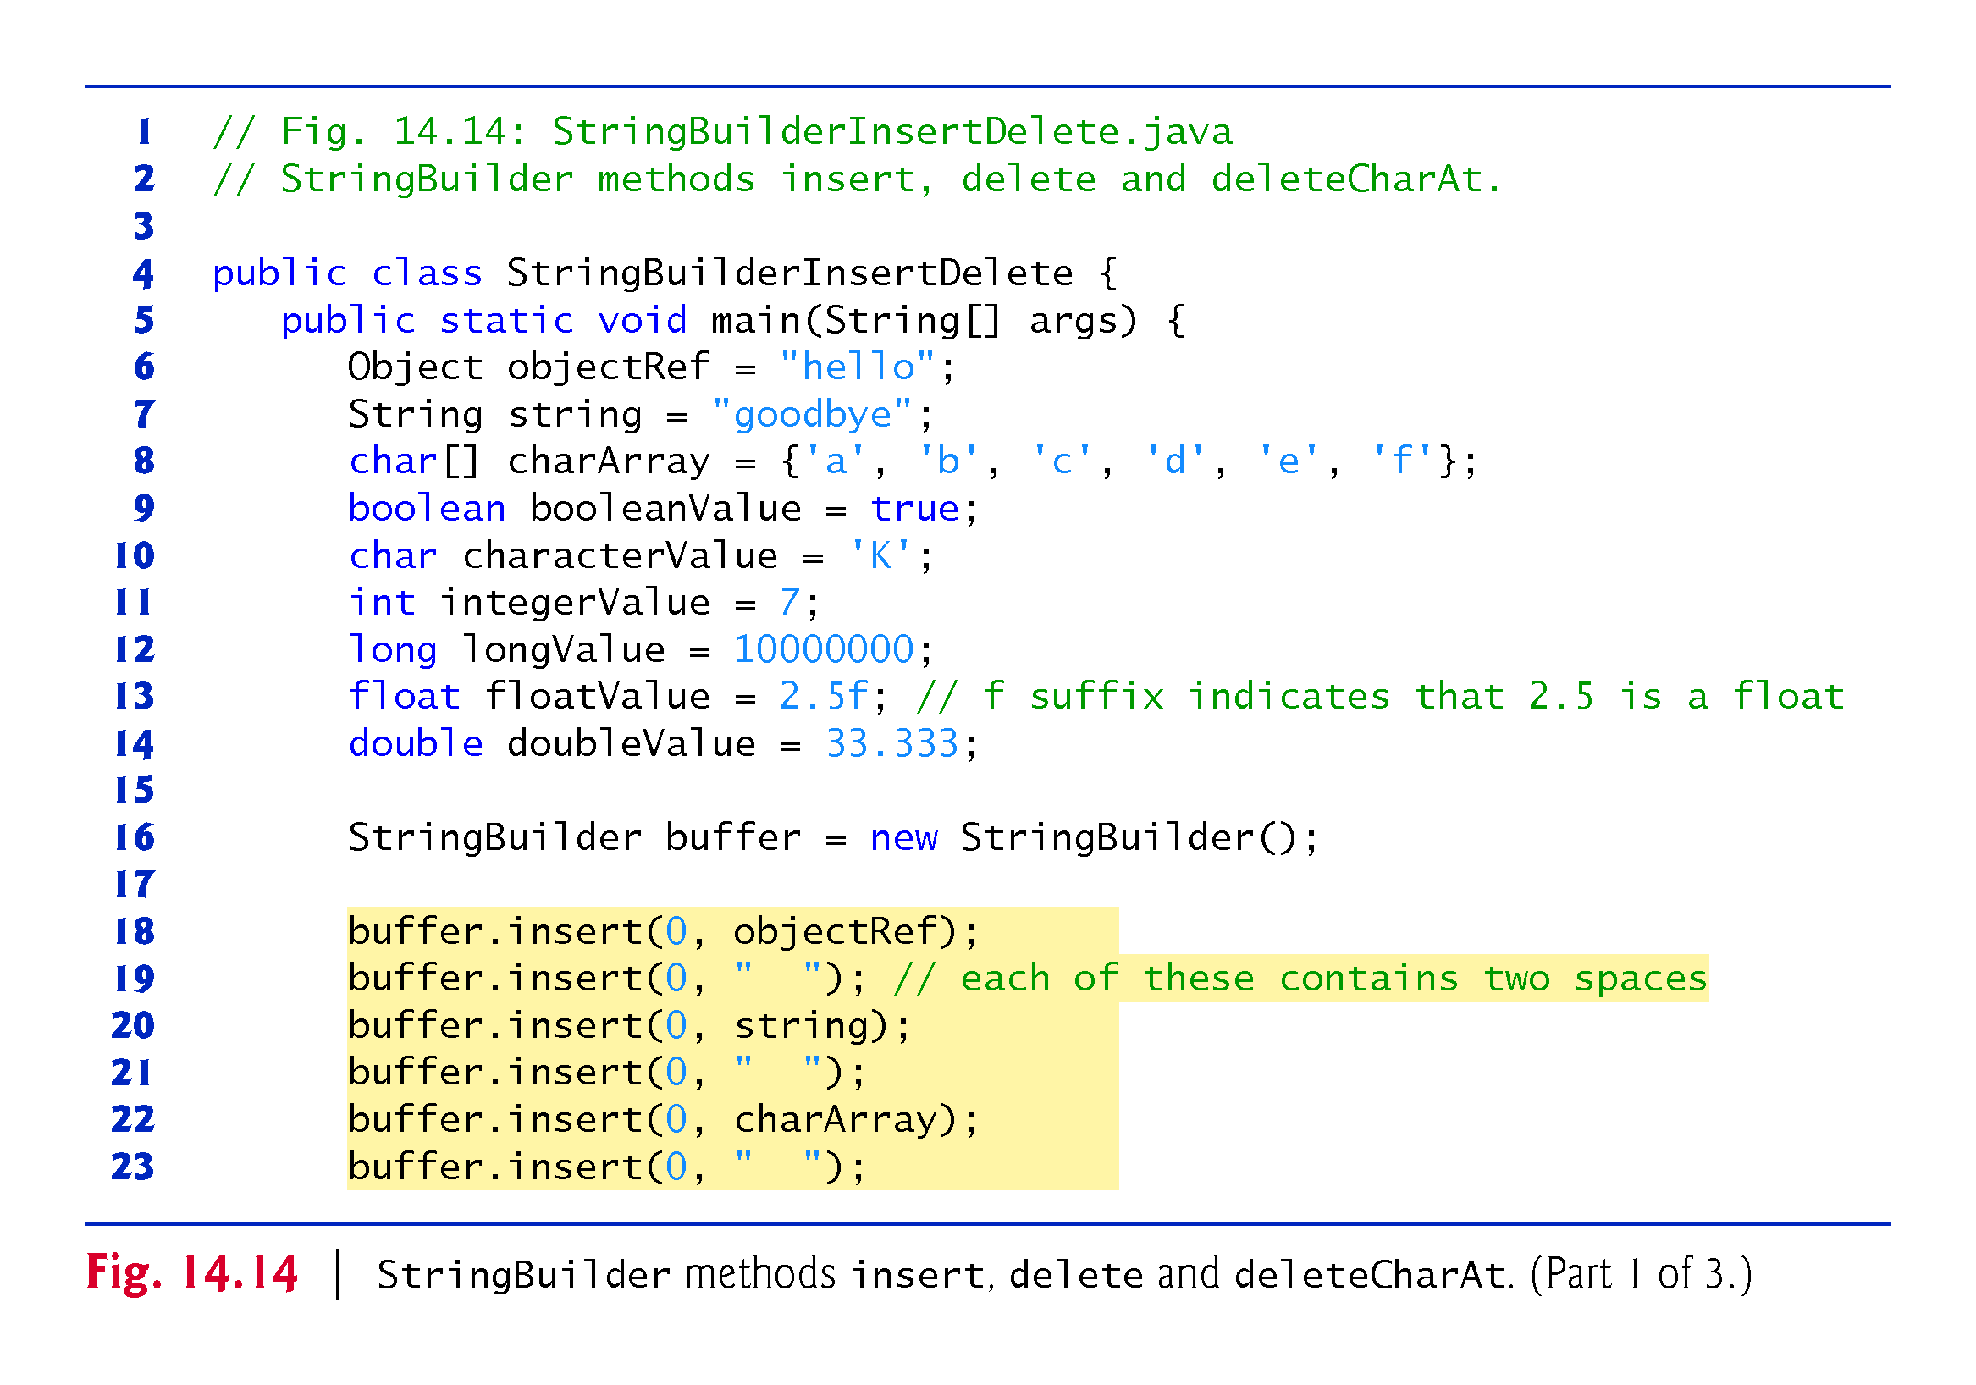

Slide 55
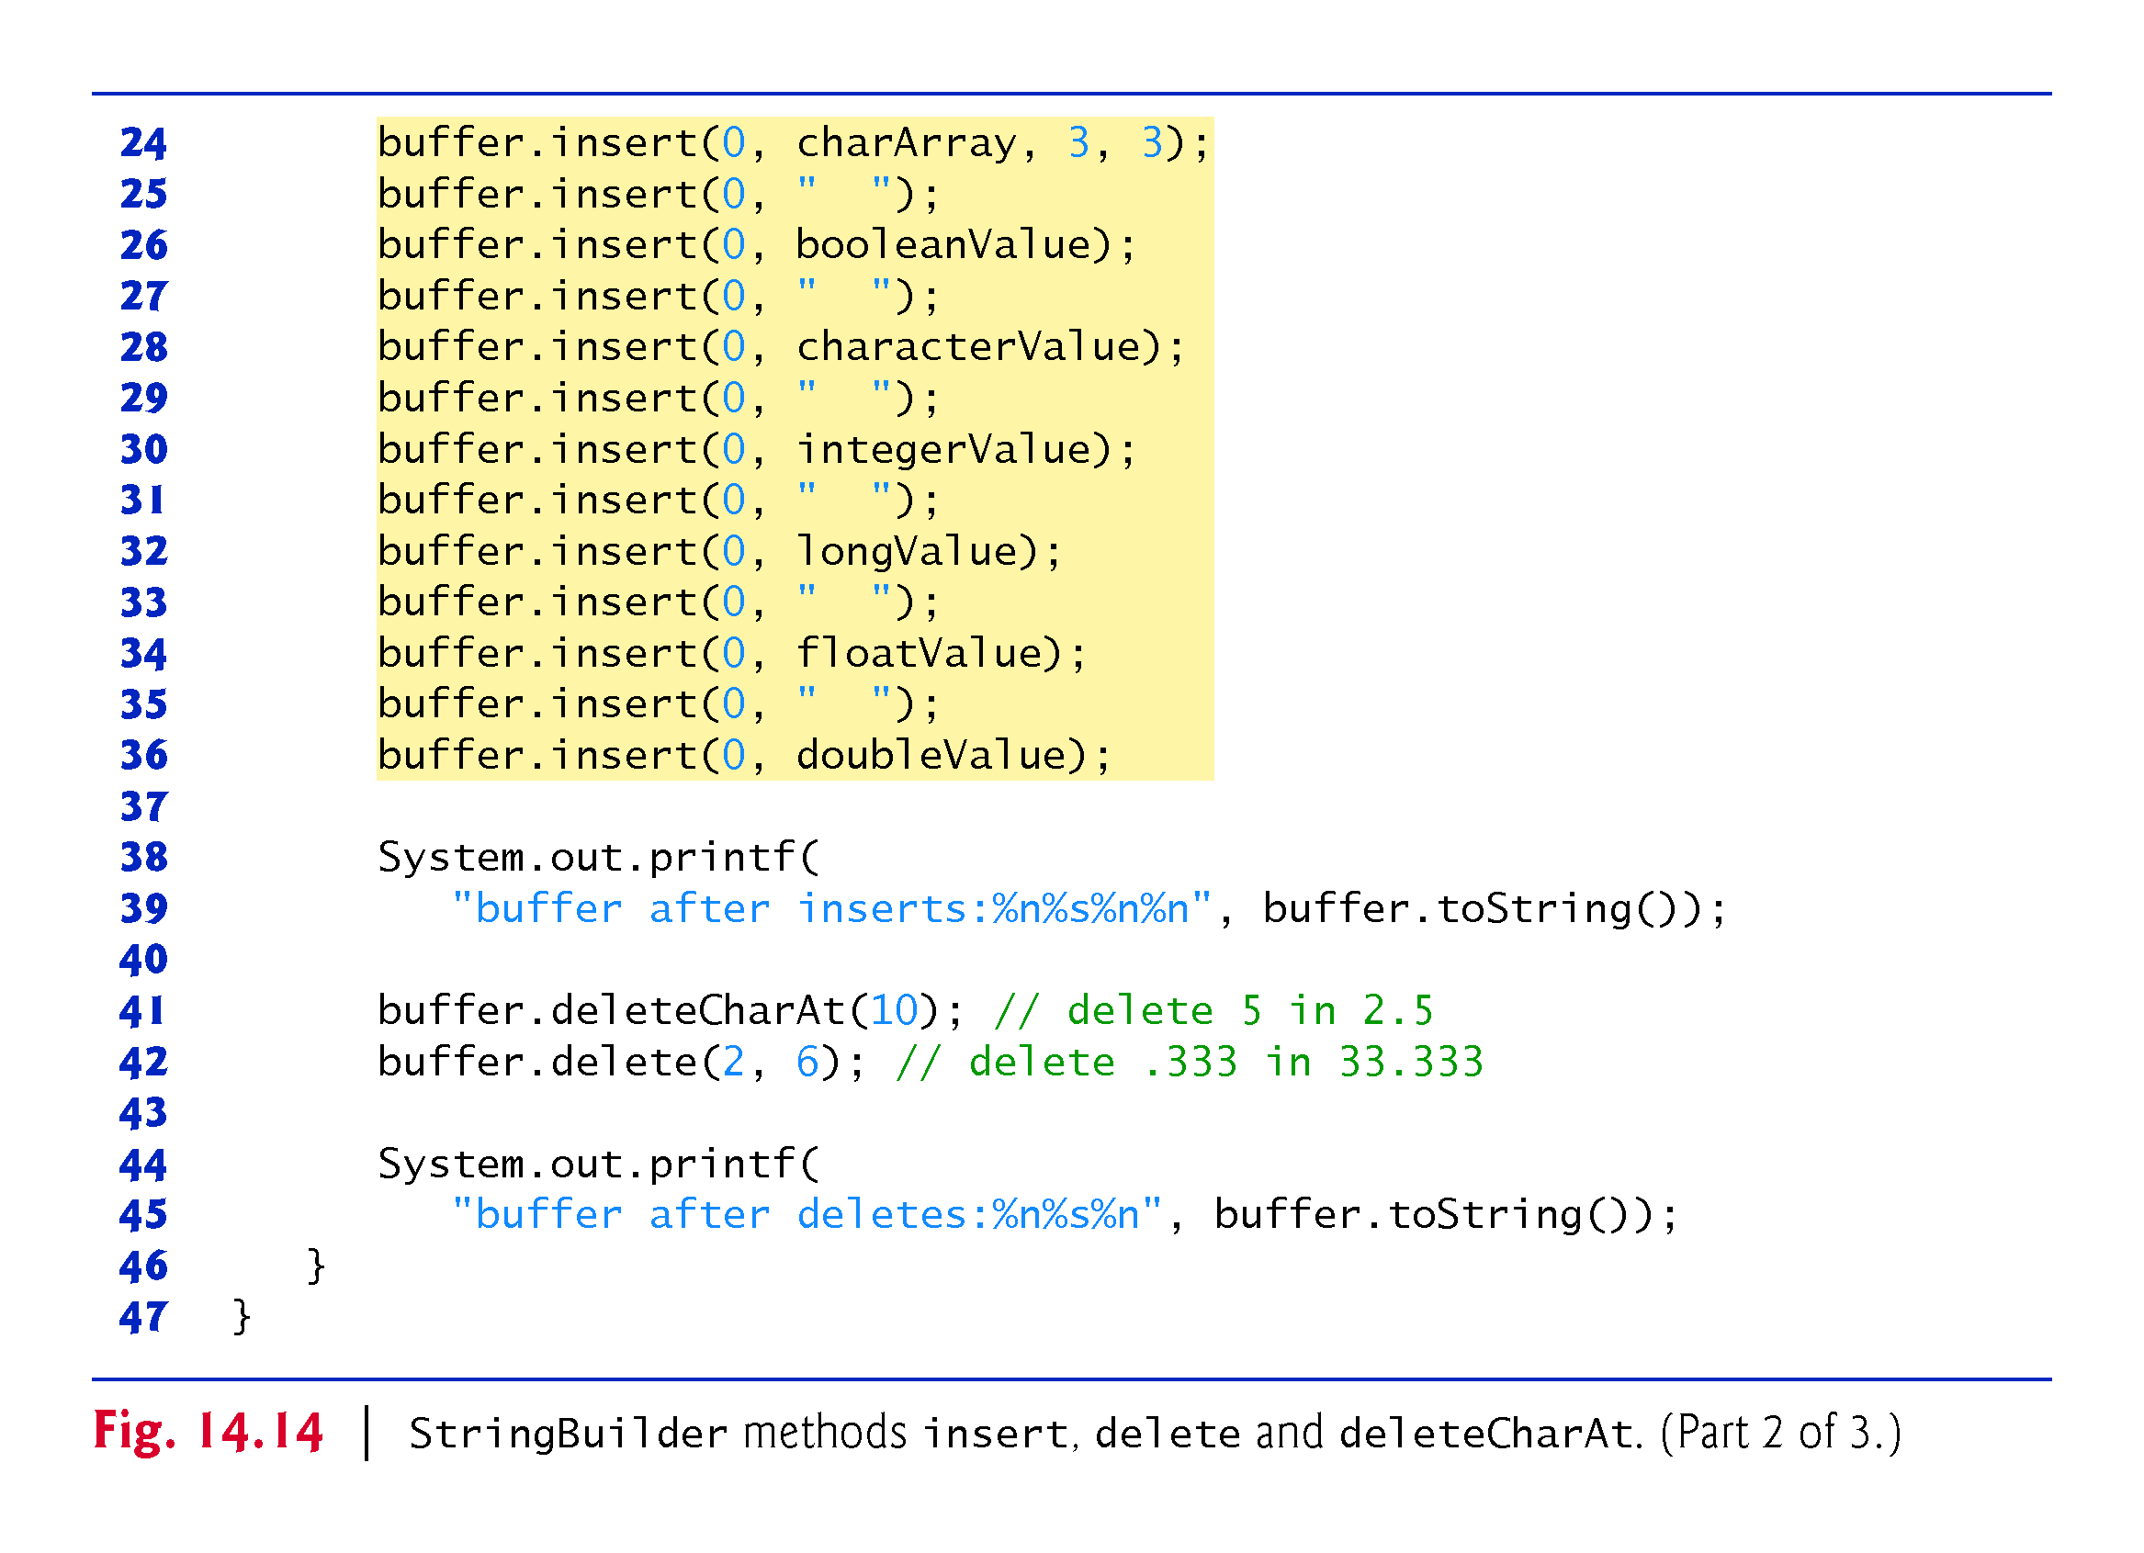

Slide 56
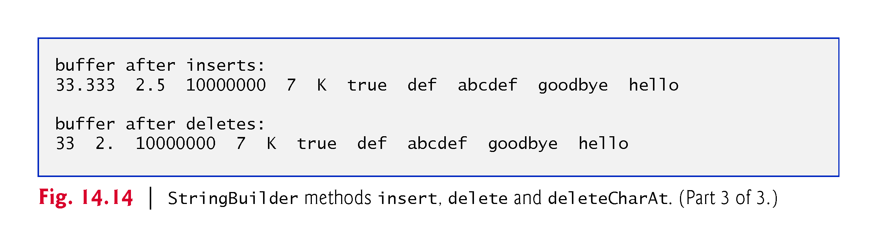

Slide 57
14.6 Tokenizing Strings
When you read a sentence, your mind breaks it into tokens—individual words and punctuation marks that convey meaning.
Compilers also perform tokenization.
String method split breaks a String into its component tokens and returns an array of Strings.
Tokens are separated by delimiters
Typically white-space characters such as space, tab, newline and carriage return.
Other characters can also be used as delimiters to separate tokens.

Slide 58
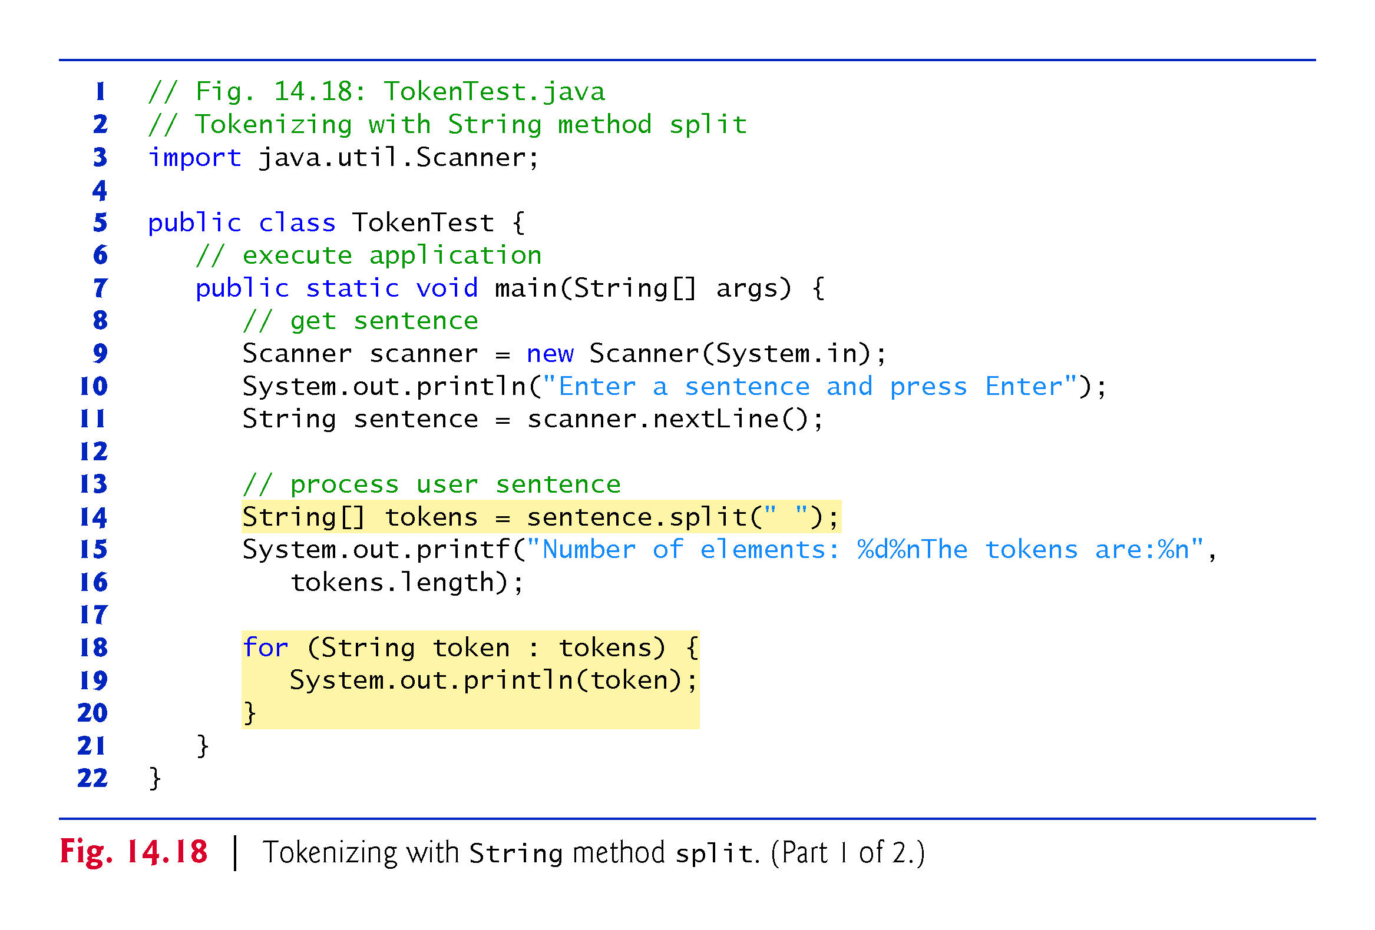

Slide 59
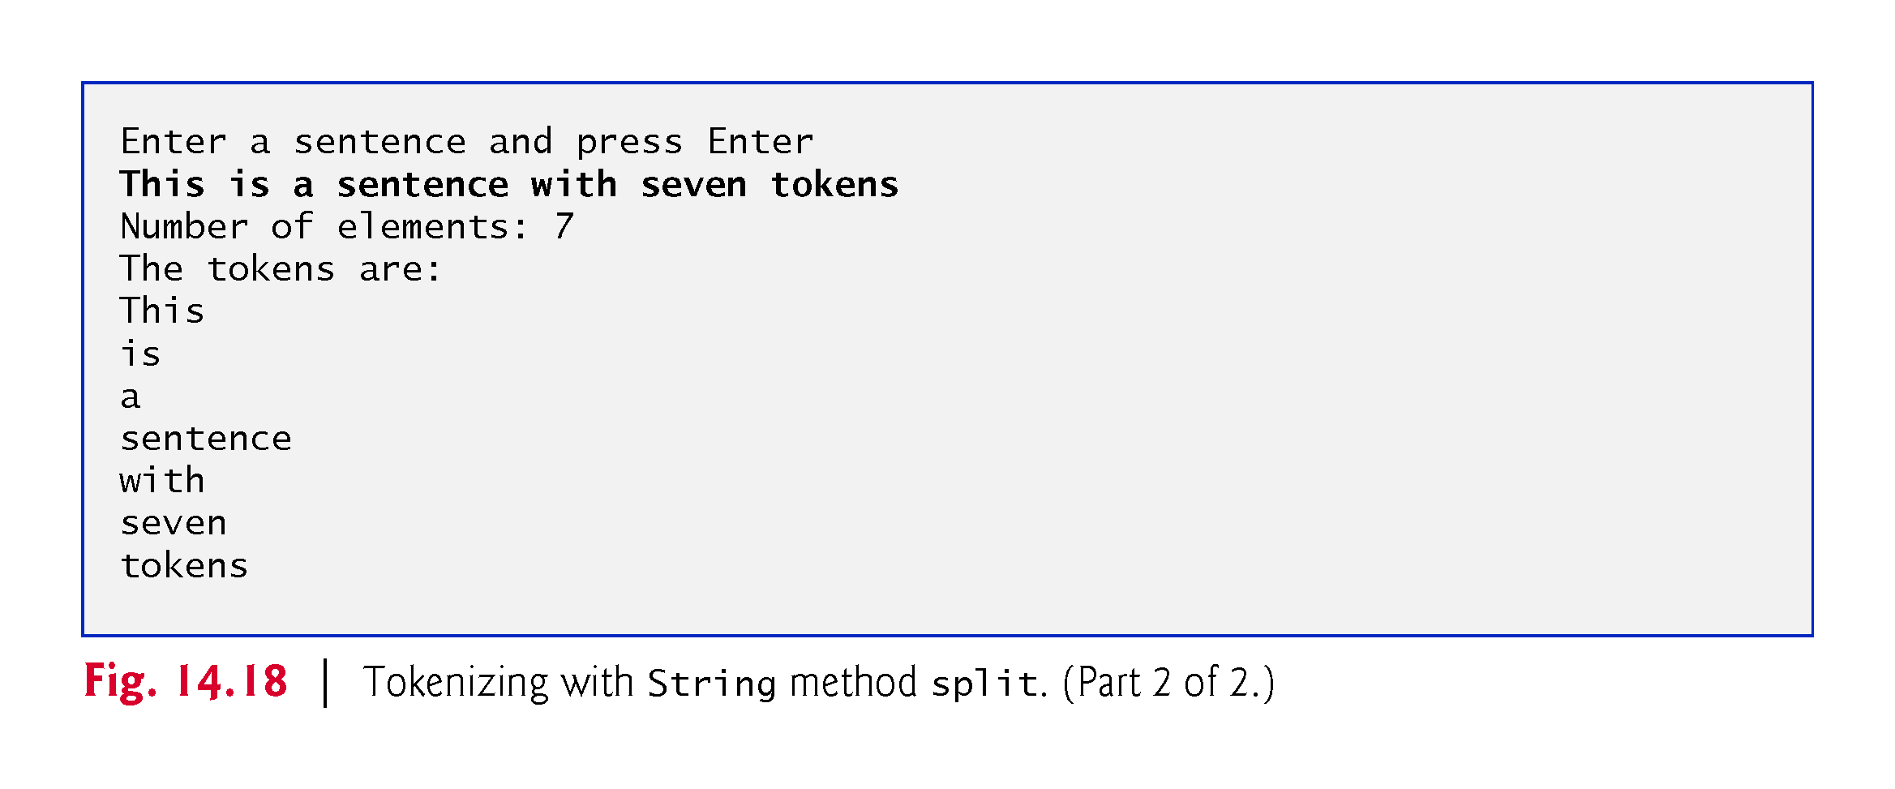

Slide 60
Chapter Objectives – What we covered
Construct and manipulate immutable character-strings objects of the class String.
Construct and manipulate mutable character-string objects fo the class StringBuilder.
Construct and manipulate objects of class Character.
Describe breaking a string object into tokens using the String method split.

Slide 61
Questions?

